Slide 1
Boa Tarde!!!
Vamos iniciar às 15:30. Até este horário, sinta-se confortável.
Antes de iniciar, garanta que você consegue acessar o sítio: https://notebooks.azure.com.
Todas as nossas tarefas serão realizadas neste sítio.
Caso você não tenha uma conta da Microsoft, crie uma em: account.microsoft.com.
Notes:
Welcome to your <location> Microsoft Reactors. We are worldwide local community spaces where developers and startup leaders meet, learn, and connect. Reactors build a diverse community by providing training, learning paths, industry speakers, and seminars, plus meetups and other community events related to emerging technology trends.
Reactor learning, networking, and leadership opportunities are designed to focus on real-world challenges to enable members of the tech community to stay up to date and drive solutions. Reactors are a place to share knowledge and expand impact in the company of technology enthusiasts locally and globally.
We have workshops and other learning opportunities planned throughout the year. Or if you want to host your own event at a Reactor, you can make the request on our website.

Slide 2
Construindo aplicações inteligentes usando IA
12/08/2020
Microsoft Reactor | SP

Slide 3
Flavio Figueiredo
Professor
Universidade Federal de Minas Gerais
@flaviovdf

Slide 4




developer.microsoft.com/reactor/
@MSFTReactor no Twitter
Notes:
Welcome to your <location> Microsoft Reactors. We are worldwide local community spaces where developers and startup leaders meet, learn, and connect. Reactors build a diverse community by providing training, learning paths, industry speakers, and seminars, plus meetups and other community events related to emerging technology trends.
Reactor learning, networking, and leadership opportunities are designed to focus on real-world challenges to enable members of the tech community to stay up to date and drive solutions. Reactors are a place to share knowledge and expand impact in the company of technology enthusiasts locally and globally.
We have workshops and other learning opportunities planned throughout the year. Or if you want to host your own event at a Reactor, you can make the request on our website.

Slide 5
Workshop Agenda
Visão geral de IA
Usando o Computer Vision e o Tradutor de Texto da Azure
Intervalo de 15 minutos
Identificação de Faces
Ética e IA
Notes:
By the end of this workshop, you will have a basic grasp of how you can implement Azure Cognitive Services in your applications.
Your hands-on work in this workshop will be centered on using Python and Flask in Visual Studio Code to call REST APIs to access Azure Cognitive Services. You will also see several different simple and advanced Microsoft Cognitive Services demonstrated.

Slide 6
Uma Revisão de IA

Slide 7


Slide 8
“Artificial Intelligence is just whatever a computer can’t do yet…”
Chris Bishop, Microsoft Research
Notes:
So it’s the continual moving of the goal post, perhaps innovation in technology itself?

Slide 9
“The science and engineering of making intelligent machines, especially intelligent computer programs.”
John McCarthy, The Dartmouth Conference, 1956
Notes:
The term “artificial intelligence” was coined by John McCarthy, an American computer scientist, in 1956 at The Dartmouth Conference.
John McCarthy said that AI is “The science and engineering of making intelligent machines, especially intelligent computer programs”.
So, artificial intelligence is a field of computer science dedicated to simulating human intelligence.
The goal of AI is to create a machine that can mimic a human mind.
As of the last 15 years, the main exciting advancements we’re seeing in artificial intelligence are coming from a domain called Machine Learning.
So then, what’s machine learning?

Slide 10
“Artificial Intelligence is computers doing things that we would normally think of as intelligent in humans.”
Rick Barazza, Microsoft
Notes:
Our working definition.
It’s not just doing things that humans do. That’s not very hard. Humans do all sorts of dumb things that much simpler animals do. So we’re setting the bar higher than that. But not crazy high. We’re saying AI is about carving out more and more pieces of intelligent behavior. And so by that definition AI is here today and has been for a while now.
Before we talk about how artificial intelligence works, let’s talk briefly about Natural Intelligence.

Slide 11

Modelo
Entrada Sensorial
Comportamento
Notes:
If we think about how we as humans process information, it’s not that different from AI. We take input from the world – sights, sounds, information. We process that through our “model” – our brain – which has been trained by both nature and nurture. We then respond to that input in what would be termed behavior.

Slide 12

Modelo
Dados
Respostas
Notes:
With artificial intelligence, it’s much the same. Setting aside the potentially scary robot drawing, we feed our computer data. Our computer uses the model we’ve built, and then provides us answers.

Slide 13
Algoritmo
Doente?
Notes:
Start with a specific question: “Is this retinal scan of a diseased eye?”
Build the puzzle by necessity. Don’t mention something new (features) until you need it.
Build the puzzle.
Talk about how you spend your time (calling out data wrangling as something that developers already do—“metadata scientist”).
Talk about math, how much you need, where you need it.
Also a chance to talk about hidden bias in data, e.g. how it skews towards men in software. So an ML “should I hire this person” would weight men heavily. The data is not bad, it’s just reflecting a situation that is itself the result of bias. The way to subtract it is to extract it explicitly.
But this is also an opportunity! We can’t subtract bias from people’s brains, but we can subtract it from models. So that “hiring engine” may in the end be a force for social justice.

Slide 14
O ponto chave é a disciplina de aprendizado de máquina!
Notes:
Machine learning is a subfield of artificial intelligence.
Technically, machine learning is a method of data analysis that automates analytical model building.
But we can think of it as a technique to train artificially intelligent systems without needing to be specifically programmed.
Instead, you create an algorithm that takes in data and uses statistics to predict an output that’s reasonably correct.

Slide 15
Entendendo o Aprendizado de Máquina
Age | Income | Education | Gender | Housing
61 | $65,000 | Moderate | F | Own
42 | $72,000 | High | F | Rent
18 | $25,000 | Moderate | M | Other
22 | $36,000 | Low | M | Rent
Dados de Treino
31 | $52,000 | High | M | ?
Conhecemos
(“features”, “attributes”,
“atributos”)
Thing to predict
(“classe”, “rótulo”)
Notes:
Okay, quick, simple example:
So, like I said, machine learning works through algorithms that take in data and use statistics to predict a reasonably correct output.
As an example, imagine you’re trying to predict whether someone rents or owns their home.
To do this, we’d need a bunch of data about all kinds of people who both rent and own homes.
In this example, we have their age, their income, their education level, gender, and of course, whether they own or rent.
… remember it in a “model”
Then, we use that model: we put in the features of the person we’re trying to guess about and the model will give us its best prediction of whether or not that person owns or rents their home.

Slide 16
Qual a Diferença?
Inteligência Artificial
Um pacote completo, pronto para usar
Fácil de integrar ações
Serviços Azure
Machine learning
Modelos matemáticos que são otimizados para cada base
Útil para problemas específicos e gerais
Sem ações
Notes:
So what’s the practical difference?
If you’ve bought something on the internet and seen “related products” for you to buy, those suggested products were almost certainly selected using a machine learning algorithm that is packaged into an experience that you, the user, consume. That’s AI.
Or if you’re on Netflix, and you’ve been watching some shows, and it suggests other shows to check out—they picked those shows using a machine learning algorithm.
Terms are often used interchangeably.
One funny and true way of remembering the difference, is that when you’re trying to sell a product, you call it AI. When you’re trying to hire someone to build the product, you call it Machine Learning.
So for the purposes of this workshop, we’re going to experiment with a set of pre-built ML models that are packaged into high-level, finished AI services. This saves you the time from building your own custom ML models and can help you add intelligence to your apps with relative ease.

Slide 17

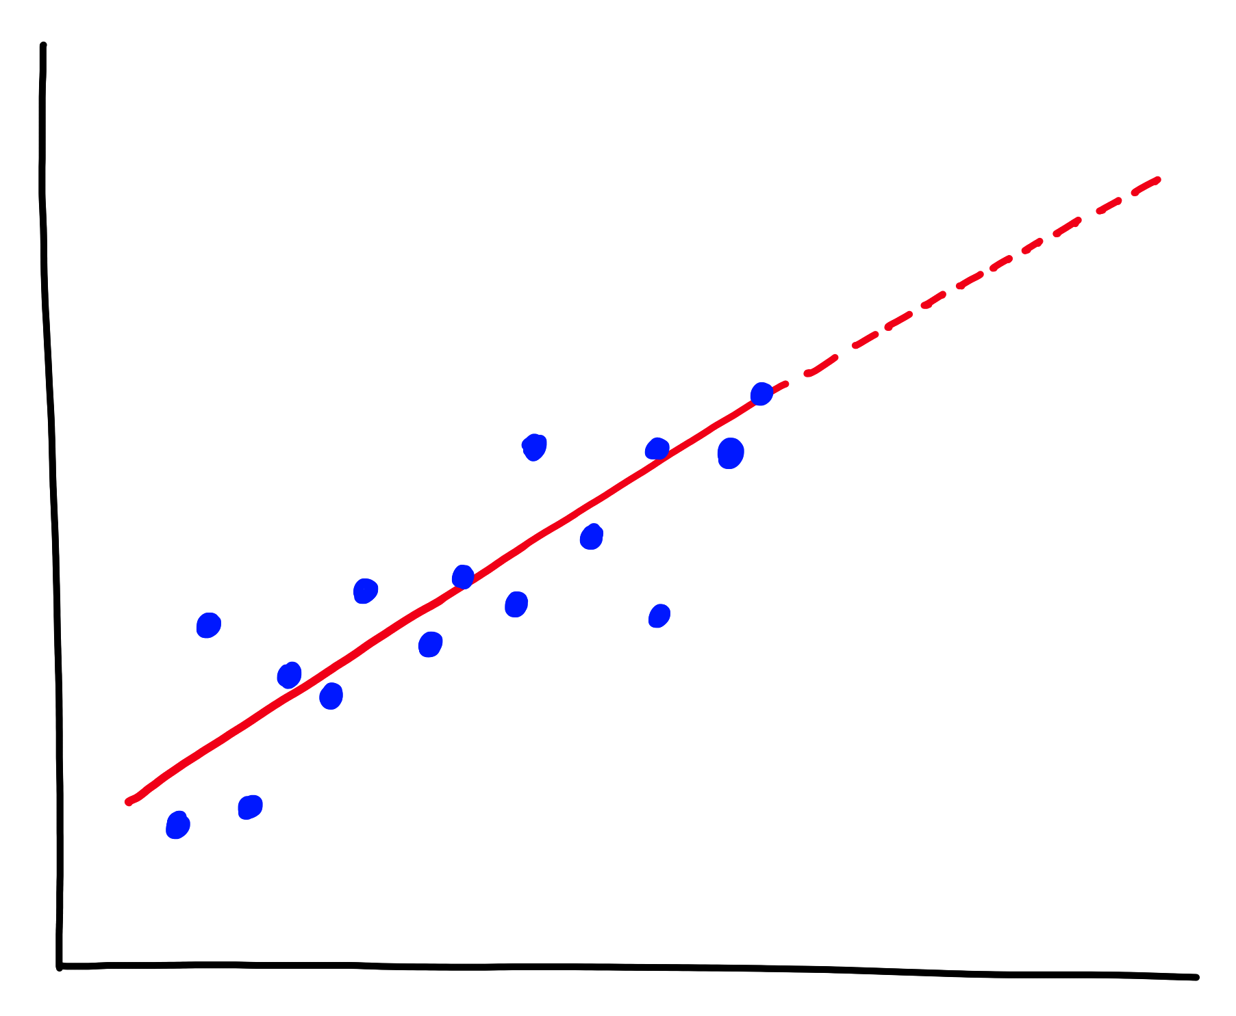
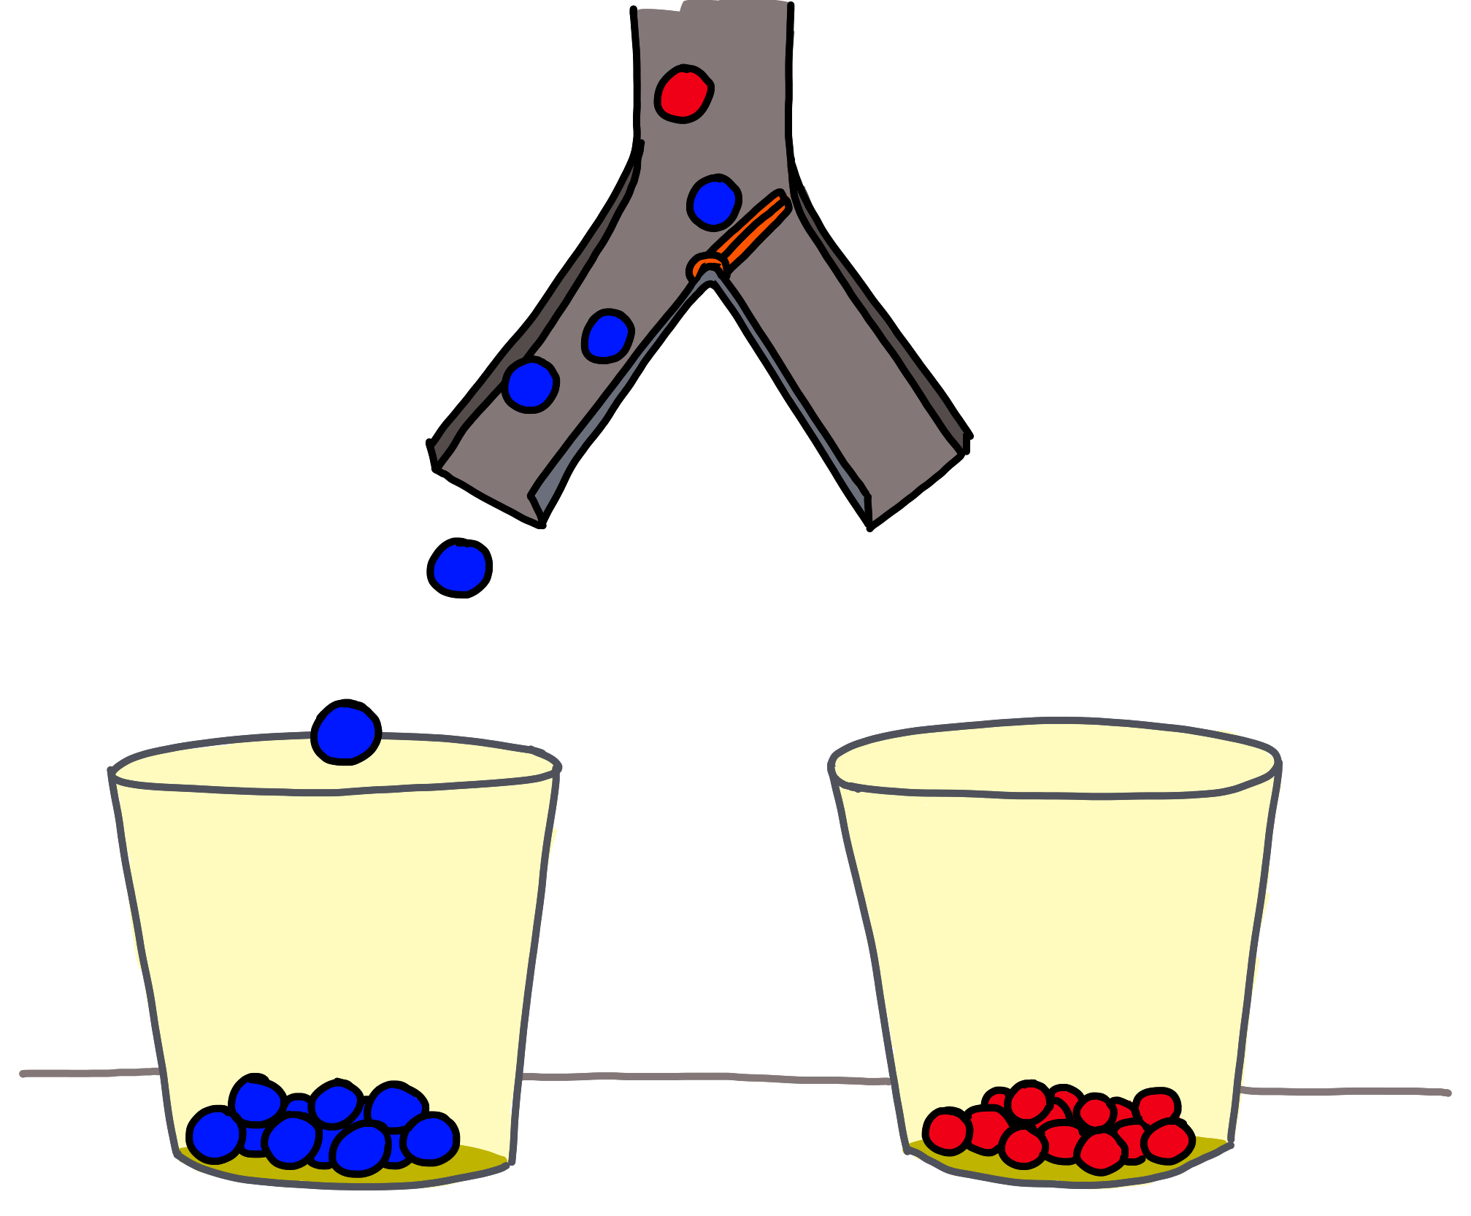
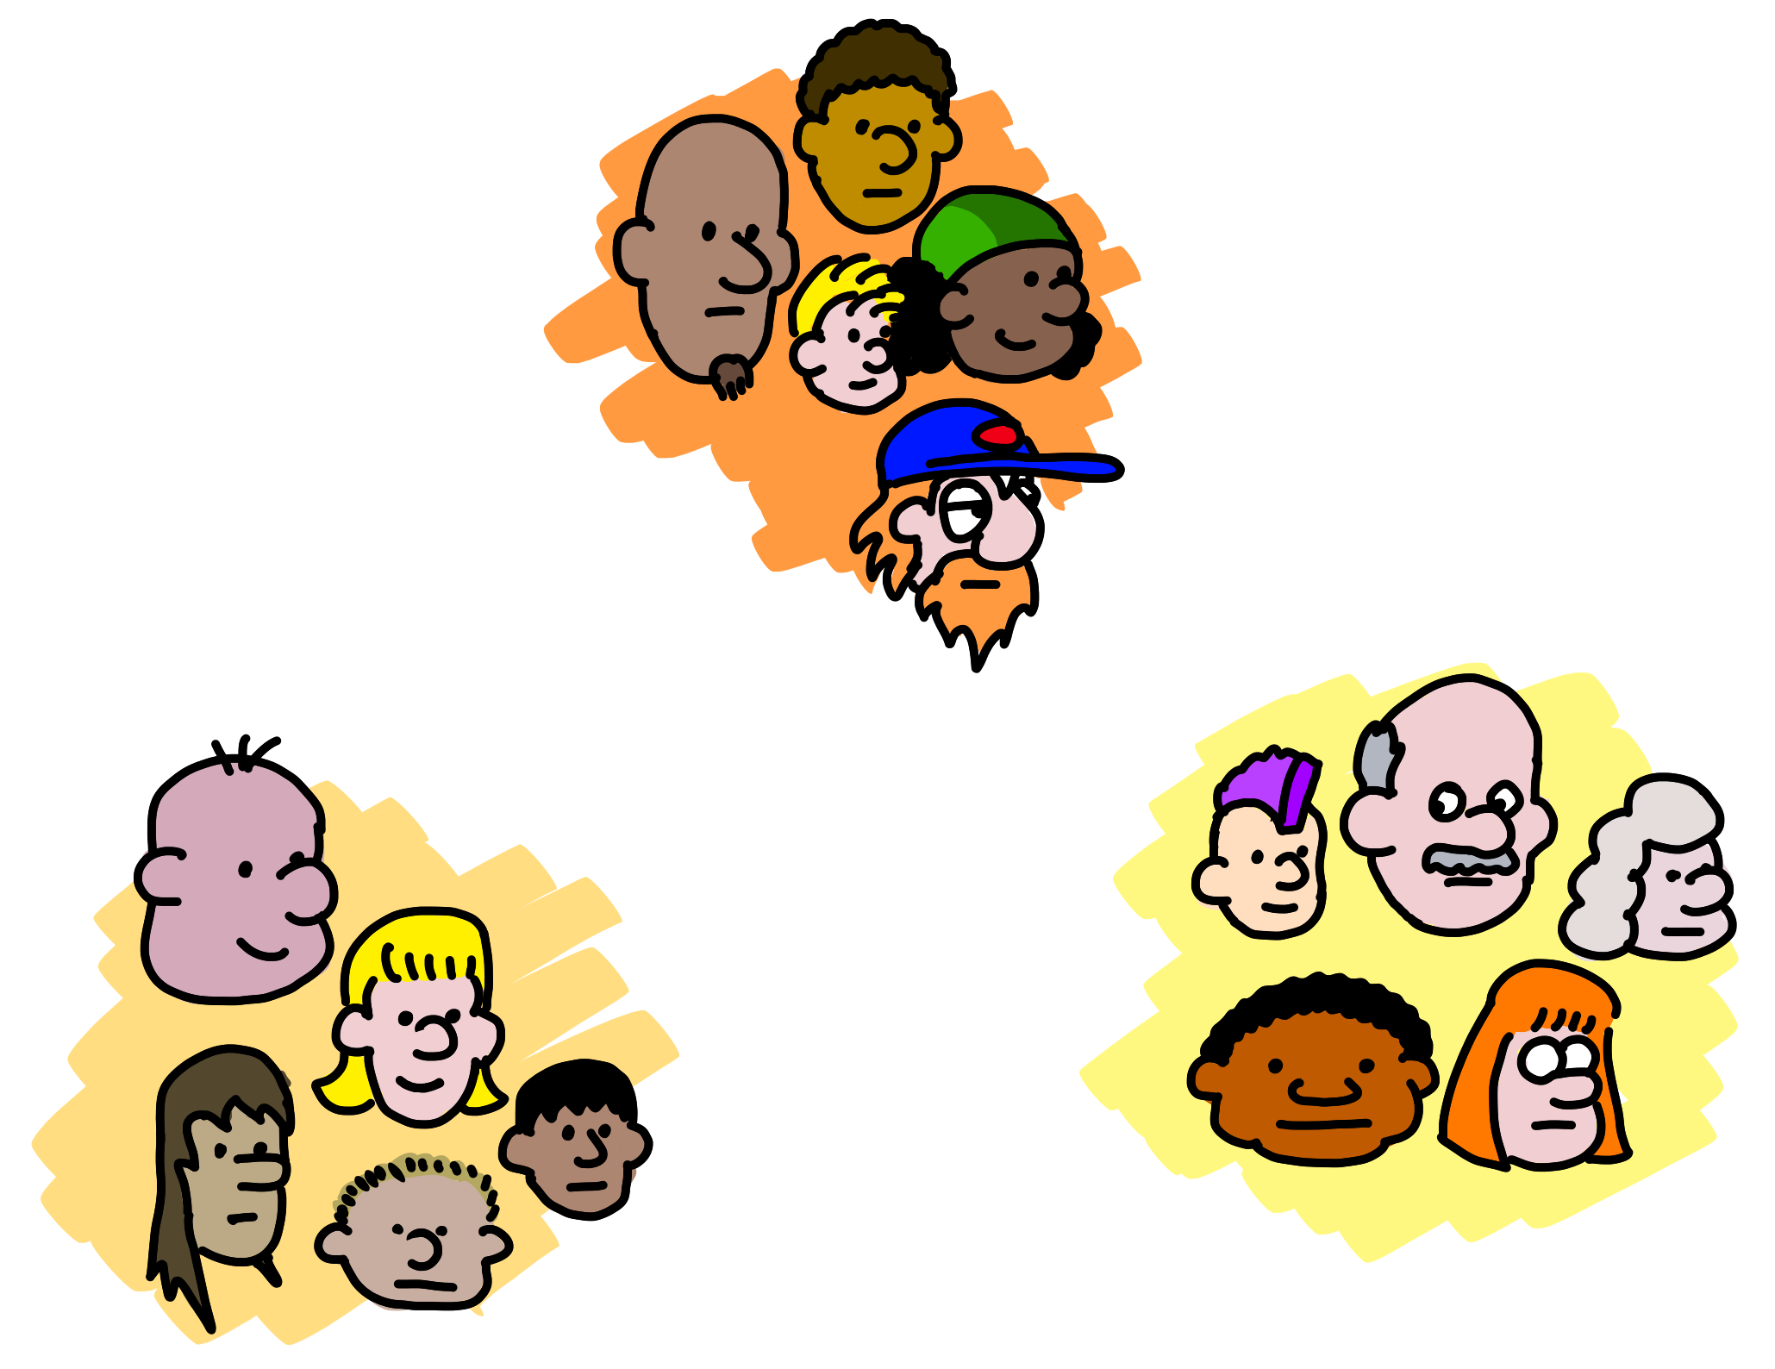

Quanto?
(Regressão)
Próximo Passo
(Reforço)
Qual Categoria?
(Classificação)
É estranho?
(Anomalies)
Estrutura
(Clusterização)
5 perguntas: Brandon Rohrer
Notes:
The five questions you can answer with traditional ML:
Regression: Predict a real value for new data given trends in this example. How much/how many? e.g. sea level rise: we are currently using data on sea level changes over the past century and the accelerating upward trend to estimate the amount of sea level rise in the coming century.
Anomaly: Identify when something unexpected happens. Is this weird? E.g. Pacemaker hacking: research is being done to detect malware in a pacemaker to prevent data hijacking or malware-related malfunctioning by using an anomaly detector to pick up changes in data transmission timing to a cardiac log or even power consumption and electromagnetic radiation changes.
Reinforcement Learning: Take some appropriate action or next step. E.g. Roomba or Roomba-competitor: a Roomba device decides whether to return to the base or vacuum the living room again. There’s some sort of reward/penalty involved here.
Classification: Assign a category to each item or data point. E.g. Exploring the night sky for planets: light curves (stellar brightness over time) of unexamined stars with Kepler data are being classified as either having transiting planets or not using a pre-trained model on stars with and without transiting planets.
Clustering/Recommenders: Get to the structure or layout of data. Are there obvious separable groups? E.g. Hepatocellular carcinoma metastasis: researchers are looking at the differential profiles of proteins being expressed to find those that are upregulated during the cell invasion process to find new cancer treatment targets.

Slide 18

http://aka.ms/MLCheatSheet
Notes:
Or if you really want to get sophisticated, Microsoft has a whole bunch of pre-trained algorithms for build your own custom ML models. But that’s more like a data science workshop.
(more context below…not necessary in this AI workshop)
The Azure ML Cheat Sheet helps you pick the right algorithm for a model, even if you're not a trained data scientist. One example is if you want to use a set of input values to predict an output value from a continuous set of values (e.g., a person's age), use linear regression. But if you're more interested in the distribution of the output, you might use fast forest quantile regression instead. An example of when you would use the latter is using growth charts to assess child development. "Abby's height is in the 10% quantile of the heights of kids her age”. Classification algorithms, by contrast, are used to predict a value from a discrete set of values--for example, classifying an e-mail as spam or not spam.

Slide 19
Onde que fazemos uso de IA?

Slide 20



A Progressive usou o Microsoft Azure Bot Service e os Serviços Cognitivos para criar o Flo Chatbot de forma rápida e fácil para responder às perguntas dos clientes e fornecer cotações.
Notes:
Auto insurance provider Progressive may be best known for Flo, its iconic spokesperson. The company wanted to take advantage of customers’ increasing use of mobile channels to interact with its brand. So Progressive used Microsoft Azure Bot Service and Cognitive Services to quickly and easily build the Flo Chatbot—currently available through Messenger at https://www.facebook.com/flofromprogressive/—which answers customer questions, provides insurance quotes, and even offers a bit of witty banter in Flo’s popular, well-known style.
As mobile has become a more important channel, Progressive has looked for ways to use it to connect with customers who want easy, personal, and trustworthy digital experiences. The insurer has found that the Microsoft Azure Bot Service and Cognitive Services APIs also make it easy to adapt and refine the bot and its responses without needing data scientists to write complex code. The APIs also provide the ability for a knowledge base to grow and learn more over time, making the responses better and better.
Find the full case study here: https://customers.microsoft.com/en-us/story/789698-progressive-insurance-cognitive-services-insurance

Slide 21


O Uber usa a Face API da Azure para ajudar a garantir que o driver que usa o aplicativo corresponda à conta no arquivo.
Notes:
It’s important to ride-sharing company Uber that the driver behind the wheel matches the driver account on file—both to protect riders and to help ensure that the drivers’ accounts haven’t been compromised. Uber decided to add photo-matching technology to an array of screening methods that it uses.
Uber turned to Microsoft for the performance, accuracy, and scalability of the Face API in Azure Cognitive Services, which can compare photos and return a match within milliseconds, even from a photo that might not be of the highest quality.
If the match is unsuccessful, the Uber platform using Azure Cognitive Services is smart enough to notice, for example, that the problem may be a reflection from eyeglasses, and it will ask the driver to remove their glasses and take their picture again.
Find the full case study here: https://customers.microsoft.com/en-us/story/731196-uber

Slide 22

Microsoft’s Aim:
Todos podem ter acesso à inteligência artificial
We are pursuing AI to empower every person and every institution ... so that they can go on to solve the most pressing problems of our society and our economy.
– Satya Nadella, CEO, Microsoft
Notes:
//See https://news.microsoft.com/futurecomputed for more info.
Microsoft’s stance is to use AI to enable and empower everyone.
Microsoft is doing this in three main ways:
Creating products that use AI in innovative ways enable all users.
Building tools that developers such as yourselves can use to create (I’ll be showing you how to use some of these tools later).
Actively contributing to the global dialogue of ethical implications of AI. We believe AI should augment human capability—help us eliminate mundane and repetitive tasks and instead be more productive and creative. Harnessing its potential also requires us to adopt an open and questioning mindset. We have a shared responsibility to ensure that that the models that we build (and the AI experiences that consume them) are fair, reliable and safe, private and secure, inclusive, transparent, and accountable. We’re working with technology communities, governments, universities, and organizations on this.

Slide 23




IA para o Bem Social
Notes:
//See https://www.microsoft.com/en-us/ai/ai-for-good for more info.
Computers can help people make better decisions through AI. Computers are very good at remembering things—absent a system failure, computers never forget. They are better at probabilistic reasoning than most people, which is powerful for making useful predictions and classification. Finally, computers excel at discerning patterns in data that are too subtle for people to notice. This “computational intelligence” that computers can provide can have a significant impact in almost any field where human intelligence has a role to play. For this reason, Microsoft seeks to combine the capabilities of computers with human capabilities to enable people to achieve more.
AI for Good is Microsoft’s commitment to providing technology, resource, and expertise to empower those working to solve humanitarian issues and create a more sustainable and accessible world.
//Talk about your favorite examples and what they mean to you personally and professionally.
AI for Humanitarian Action (https://www.microsoft.com/en-us/ai/ai-for-humanitarian-action?SilentAuth=1&wa=wsignin1.0) will harness the power of AI to focus on four priorities—helping the world recover from disasters, addressing the needs of children, protecting refugees and displaced people, and promoting respect for human rights.
Project Premonition (https://www.microsoft.com/en-us/research/project/project-premonition/)
AI technology and cloud software enables Project Premonition researchers to detect and track pathogens to prevent outbreaks and protect biodiversity.
Operation Smile gives hope to more children
Nonprofit partner Operation Smile uses a facial modeling algorithm and Microsoft Pix to improve their surgical outcomes and help more children in need of facial surgeries.
The Yield
How do we feed the world without wrecking the planet? The Yield uses Microsoft AI to help farmers create localized predictions, so they know exactly when to plant, when to water, and when to harvest to create more food and less waste.
Iconem
Historical sites are disappearing every day. The team at Iconem uses Microsoft AI to help preserve ancient architectural sites for future generations.

Slide 24

Wild Me + Microsoft
Notes:
Microsoft works with a company called Wild Me on a project called Wildbook®. Wildbook is an open-source framework for wildlife data management that seeks to identify and track specific, individual animals from endangered species in the wild. Wildbook uses Azure Cognitive Services to do this.
To learn more about Wildbook and see it in action, visit wildbook.org.

Slide 25
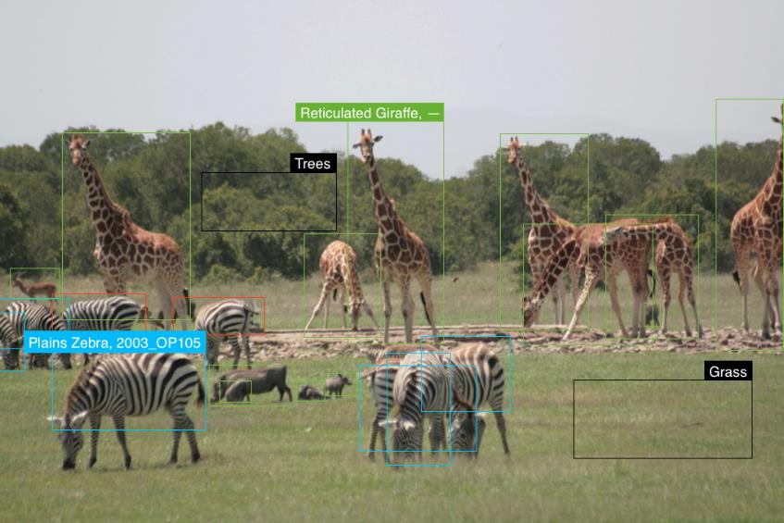
Identificação de Espécies
Notes:
Wildbook can use Microsoft Cognitive Services to detect and identify not only animals based on their species. But also…

Slide 26

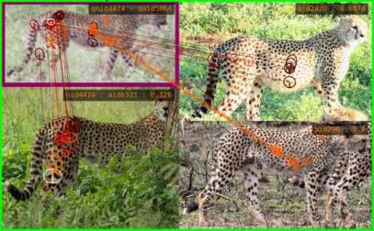
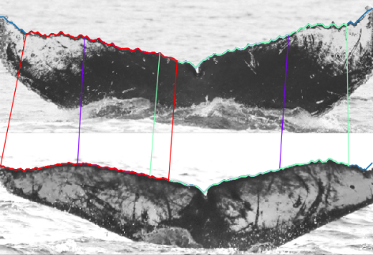
Identificação de Indivíduos
Notes:
It uses custom vision services plus custom models to identify individual animals based on unique traits.
For example, zebras have specific stripe patterns, elephants have wrinkles, and whales have unique ridges on their tails.
So, every type of animal needs a specifically trained model that can be used for making and recapturing that animal.
No out-of-the-box content management system (CMS).
Build it: Wildbook—open-source framework for wildlife data management: http://www.wildbook.org.
Rapidly share research techniques, tools, and investments across groups and species (even if not directly collaborating).
Filter, search, and export data.
Engage citizen scientists!
47,000+ sighting records
9100+ whale sharks
5900+ individual data contributors
40 participating organizations
75%+ success rate for submitted data leading to identifications
Long list of publications
Critical data contributor for IUCN Red List of Threatened Species
We foresee a world where:
Intelligent agents collect and curate big data for wildlife by using largely unsupervised AI.
Data sources are heterogeneous but blended.
Population estimates for species are generated continuously.
Wildlife researchers focus on analysis and not curation.
Conservation action is continuously refined.

Slide 27
Demos! https://how-old.net/ and https://what-dog.net/

Slide 28
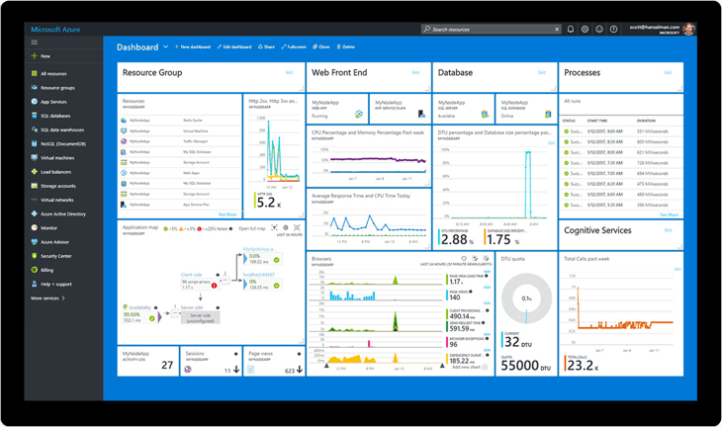
Demos Azure de Graça por um Mês
azure.microsoft.com/free/
azure.microsoft.com/free/azure.microsoft.com/free/students/
Notes:
https://azure.microsoft.com/free/
Pros: $200 for 30 days + Always Free tier
https://azure.microsoft.com/free/students/
Students: $100 for 12 months + Always Free tier

Slide 29
Hands-On Visão Computacional É essencial seguir os passos daqui! https://github.com/microsoft/Reactors/tree/main/workshop-resources/ai-services/AI_1
Notes:
Start to do some hands on
Learning python basics
1 Hour for just python and flask

Slide 30
Azure Cognitive Vision & Language
Objetivos
Criar um ambiente de desenvolvimento
Aprenda (ou uma pequena revisão) de Flask
Crie uma página que aceita uploads
Chame a API de Visão Computacional
Traduza o texto extraído das fotos!
Premissas
Experiência em programação

Slide 31

Vamos ver dois usos de IA nesta aplicação
Notes:
As we saw in Section 1, AI is a tool whose usefulness spans the practical and the inspirational. We can sometimes see that range of capabilities even within a single app. For example, consider an application that can help translate signage in a foreign language. Such an application would be useful for tourists on vacation; the same application could also help save lives for doctors traveling out into the countryside of another country to stop an epidemic before it can spread (such as doctors in rural Guinea during the 2014 Ebola outbreak).
In this module, you build a step-by-step versatile web application like this—a website named “Contoso Travel”. Users of this website, whether traveling for business or for pleasure, will be able to upload photos of street signs taken from their phones to the website, where they will be able to see a translation of the signs. In order to provide this service, the app will extract text from uploaded photos through the Computer Vision API and then use the Translator Text API to translate the extracted text into the language of choice of the user.
To produce this website and application, you will use Python—already among the world’s most popular programming languages—and the Flask framework for Python web applications. Don’t worry if you aren’t familiar with either Python or Flask; we will cover enough of both in this section to produce the website.

Slide 32





Serviços da Azure
Web Apps
Mobile Apps
Web Apps for Containers
API Apps
Notes:
Azure App Service is a Platform-as-a-service in the cloud—that means it’s fully managed by Azure so that you can have your app up and running in minutes. For student developers, this is the perfect way to experiment with building a web app or mobile app because you can focus your efforts on creating the next great idea. And once it becomes your startup, you can scale it up for millions of users.
Web apps are probably your best bet for experimentation because you can try different libraries—Azure supports .NET, Java, Node.js, PHP, and Python on Windows or .NET Core, Node.js, PHP or Ruby on Linux—or different deployment tools like Visual Studio Team Services, Bit Bucket, and GitHub, etc. It also supports common CMS platforms like WordPress, Umbraco, Joomla!, and Drupal. Best of all, a web app can easily be accessed on any mobile phone or PC.
If you want to build a native experience like for iOS, Android, Windows, or Mac, then you might consider mobile apps. Azure helps you build-in native features like offline data sync, accessible design, push notifications, and account sign-in.
You can also deploy your apps to containers like Docker or Go and build your own APIs when you’re ready!

Slide 33
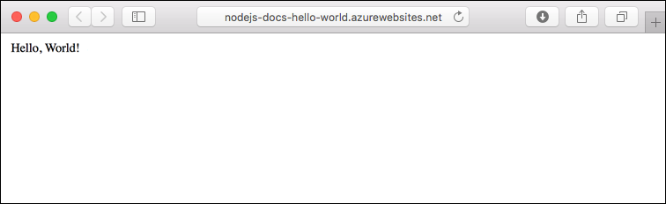
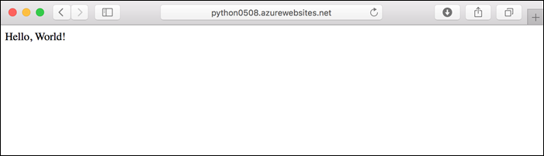
Realmente é Muito Simples!
Notes:
One of the elegant things about cloud-deployed web apps is that you get to pick your preferred language. Like this “Hello World” example in both node and python. Take your pick and build from it! Start pulling in popular libraries like React, Angular, Express, Django, and so on.
//this is a simple example just to reinforce the potential of app services.

Slide 34
Construa com Escalabilidade na Nuvem!
Inactivity
Period
Compute
Compute
t
t
Ligado e Desligado
Picos não recorrentes
Economias
User CPU apenas quando necessário
Infelizmente, quando é muito grande temos problemas
Compute
Compute
t
t
Crescimento rápido
Picos recorrentes
Você pode ir adicionando recursos ao necessário
Serviços com sazonalidade
Menos recursos à noite, mais pela manhã
Notes:
Let’s talk a bit more about why deploying a web or mobile app to the cloud matters especially say, in contrast, to localhost. Turns out that different apps have vastly different usage patterns. This is uniquely an engineering problem that cloud computing is quite capable of…relative to, say, having a small server under your dorm room desk or later paying a bunch of money for servers at your startup. Let’s look at these common usage patterns.
//feel free to read slide and ad lib your own common scenarios. Examples below:
If you were building the next Facebook, your usage might grow exponentially in the first few years…and so your demand for computing power would similarly grow. Azure grows with you. In fact, you can scale up automatically if you wanted.
Let’s say you’re the lead developer of a large worldwide soccer tournament or the Olympics where 98% of the user volume will hit your app within a 6-week period. You’d have to design your back end very differently than the Facebook example.
Maybe you work for a company that processes payroll and so peak volume occurs only at the end of the month. The point here is that Azure can be configured for all of these.

Slide 35
“Scale Up” vs “Scale Out”
“Scale Up”
Scale Out
Aumente o tamanho da VM
Aumento o número de VMs
1 Core w/ 1.75 GB RAM 2 Cores w/ 3.5 GB RAM 4 Cores w/ 7 GB RAM
Max 3* instances Max 10 instances Max 20/50** instances
Notes:
Another distributed computing concept is the difference between scaling up and out. With a traditional server farm, there are two ways to scale to meet demand:
Scaling up means you beef up the server specs (more RAM, more cores, GPUs, premium disks, etc.)
Scaling out means you add additional servers (presumably with the same specs) to chain together relative compute.
Both approaches have pros and cons, and there’s no clear answer for which one is better. It’s depends on your app and usually a combination of both is ultimately the right approach. For example, if you have an app that requires a lot of upfront memory to store graphics files or cache the experience, you’re going to need a minimum level of compute that can only be achieved by scaling up. Some apps require a lot of memory or storage that would most easily be solved by scaling up.
But now that same app is being pinged by millions of users. Chances are that a scaling out strategy would work best once you.
If you’re a student dev, we’d recommend scaling up first while experimenting with the minimum requirements of your app. Then scale out appropriately.

Slide 36
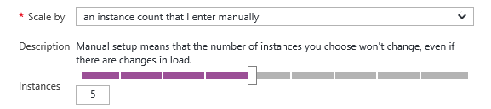
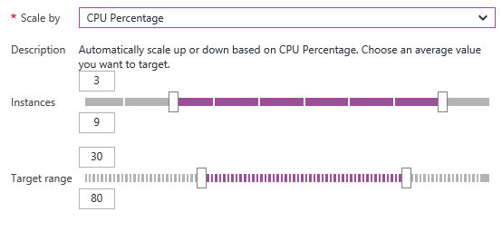
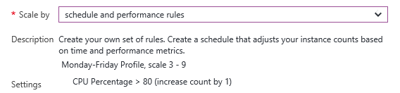
Escala Manual e Automática
Manualmente
Automaticamente
Via Regras
Notes:
Fortunately, cloud platforms like Azure often don’t force you to choose. You can manually scale out by moving a slider bar to increase or decrease the number of instances. Or you can switch app services plans to scale up.
But auto scaling is most interesting. Let’s say that you set a rule to automatically scale when your CPU processor reaching over 80% to scale out but then when CPU sustains a period of time below 10%, you scale back. This allows you to accommodate peak demand without compromising the user experience and then you can use the telemetry to make more long-term decisions on scalability. Very cool.

Slide 37





Fazendo a Implantação (Deploy) do seu APP
Production
5
1
4
Azure DevOps
2
3
Source Control
Staging
Test
GitHub
Notes:
Working with a team and DevOps is a core skill every student developer should learn—whether you’re contributing to an open source project, starting your career in a large organization, or building your startup.
Azure also makes source control much easier by giving you choice of using GitHub, Azure DevOps, or many more. Eventually, you may build a staging environment that allows you to build new features into your product without impacting your existing user base. You can even automate how you test. The point here is that Azure grows with you.

Slide 38
Python
Python é uma linguagem de uso geral com bastante usos: scripting, aprendizado de máquina e ciência de dados, desenvolvimento de sistemas
Aberta
Flexível
Orientada a Objetos
Procedural
Funcional
Diversos usos
Source: Wikipedia
Notes:
Since its first release in 1991, Python has risen to become a popular general-purpose programming language. Because Python is easy to pick up for programmers familiar with other languages, this section provides only a quick overview of the specific Python syntax we will use to create our website.

Slide 39


Crie um Ambiente Virtual Python
Baixe de python.org
Adicione Python 3.7 no seu PATH. O instalador deve sugerir isto.
Instale Python
Windows: python -m pip install --upgrade pip
macOS/Linux: python3 -m pip install --user --upgrade pip
Atualize o PIP
Crie um diretório para seu projeto
Crie um vritualenv
Crie um diretório
Windows: $ python -m venv $ env env\scripts\activate
macOS/Linux: $ python3 -m venv env $ source env/bin/activate
Ative o VirtualEnv
pip install Flask
pip install azure-cognitiveservices-vision-computervision
Instale Flask e and SDK
Notes:
The first order of business is to set up a development environment for websites written in Python and Flask. This will enable you to build and test Contoso Travel locally prior to deploying it to Azure and making it available publicly.
In this unit, you will install Python on your computer if it isn’t already installed. Then you will create a virtual Python environment and install Flask and the Python SDK for the Computer Vision API. The latter makes it easy to call Azure’s Computer Vision API from Python applications. Finally, you will install the Azure CLI, which provides a command-line interface to Azure.
1.a. Create a virtual Python environment
In order to run Flask websites on your computer, both Flask and Python must be installed. Here, you create a virtual Python environment that isolates the packages you install from others on your computer. Then install Flask and the Python SDK for the Computer Vision API in that environment.
If Python 3.6 or higher isn’t already installed on your computer, go to python.org and install it now. You can determine whether it’s installed on Windows by running the following command in a Command Prompt window: python –version Similarly, you can check to see whether it’s installed on macOS or Linux by running the following command in a terminal: python3 –version If Python is installed, the version number will appear in the output. If you install Python and are asked during the install process whether Python should be added to your system path, answer yes.
If you are running Windows, run the following command to install the latest version of pip, the Python package manager: python -m pip install --upgrade pip If you are running macOS or Linux, use this command instead: python3 -m pip install --user --upgrade pip This is important because older versions of pip may miss some of the dependencies needed for execution in Azure.
Create a directory on your hard disk in the location of your choice. This will be the project directory and will hold the files that create the Contoso Travel website. It is also where your virtual Python environment will be created.
In a command prompt window or terminal, run the cd command to switch to the project directory. If you are running Windows, use the following commands to create a virtual environment in the “env” subdirectory and activate the environment: python -m venv env env\scripts\activate If you are running macOS or Linux, use these commands instead: python3 -m venv env source env/bin/activate
Now run the following commands to install Flask and the Python SDK for Azure’s Computer Vision API in the virtual environment: pip install Flask pip install azure-cognitiveservices-vision-computervision
Leave the command prompt window or terminal open so that you can easily return to it later. When you run the website, you will want to run it from this directory with the virtual environment active.
1.b. Install the Azure Command-Line Interface (CLI)
The Azure CLI is a command-line environment for creating and managing Azure resources. Versions are available for Windows, macOS, and Linux. In subsequent units, you will use the Azure CLI to create various Azure resources, including an Azure App Service to host a website. Here, you will install the Azure CLI and sign in to it for the first time.
If the Azure CLI isn’t installed on your computer, go to the Azure CLI webpage and install it now. You can determine whether it’s installed by executing an az -v command in a command prompt window or terminal. If the CLI is installed, a version number will appear in the output.
In a command prompt window or terminal, sign in to Azure with the following command: az login In the ensuing browser window, sign in using your Microsoft account credentials. Then close the browser and return to the CLI.
Type the following command to list the Azure subscriptions associated with your Microsoft account: az account list The default subscription—the one used to create resources created with the CLI—is marked isDefault=true. If that’s the subscription you want to use, or if it’s the only subscription in the list, you’re done. Otherwise, use the following command to designate one of the other subscriptions as the default, replacing SUBSCRIPTION_ID with the ID of that subscription: az account set -s SUBSCRIPTION_ID
If you aren’t familiar with the Azure CLI, you can learn more about it and the numerous commands it supports in Get started with the Azure CLI. Most operations that you perform in Azure can be performed with the CLI or through the Azure Portal. Power users tend to prefer the CLI, in part because CLI commands can be used in scripts to automate repetitive tasks.

Slide 40
Resumo de Python
Variáveis
Listas
>>> country = "France"
>>> continents = ["Africa", "Asia"]
Dicionários
Inserindo elementos na Lista
>>> capitals = {"France": "Paris",
"Germany": "Berlin"}
>>> continents.append("Europe") >>> continents
["Africa", "Asia", "Europe"]
Notes:
Variables
As in other programming languages, it is often essential to save values for using variables in Python later. Python assigns values to variables using the equals sign (=). (Note that one initial stylistic difference between Python and Java, for example, is that Python does not conclude line with semicolons).
Data types
Python has many compound data types used to group together other values. We will use two of them to build this website: lists and dictionaries.
Lists
The most versatile compound data type in Python are lists. Lists in Python can be written as a sequence of comma-separated values (items) between square brackets. Lists might contain items of different types, but usually the items all have the same type. Python includes many handy functions that are available to all lists. The one we will use in this section is append(), which enables you to add to the end of a list.
Dictionaries
The other Python data type that we will use in this hands-on section are dictionaries. Dictionaries in Python provide a means of mapping information between unique keys and values. You create dictionaries by listing zero or more key-value pairs inside of braces. The keys for dictionaries that we will use in this section will all be strings.

Slide 41
Resumo de Python
If
For
>>> y = 5
>>> if y % 2 == 0:
... print("Even")
... else:
... print("Odd")
...
Odd
>>> for continent in continents:
... print(continent)
...
Africa
Asia
Europe
Notes:
Control flow expressions
Although Python has many control flow expressions familiar to programmers coming from other languages, we will use only two in this section: the if statement and the for loop.
If statements
If statements in Python are similar to those in other programming languages like Java, and they will form the backbone of the logical flow of our Python coding in this section.
Notice that, in contrast to Java (and other languages), Python does not use curly brackets to denote the contents of a loop. Instead, Python relies on indentation for this. (Per the official Python style guide, you should use four spaces per indentation level).
For loops
It will be necessary in programming our website to iterate over the items in lists. We will use for loops to accomplish this.

Slide 42
Funções e Exceções
Funções
Exceções
>>> def list_length(l):
... return len(l)
...
>>> list_length(continents)
3
>>> while True:
... try:
... x = int(input("Please enter a number: "))
... break
... except ValueError:
... print("Invalid number. Try again...")
...
Notes:
Functions in Python
As in other programming languages, it is often essential in Python to break down programs into reusable chunks. A primary means of doing that is through functions.
Note again that indentation rather than curly brackets denotes the body of the function. Also note that, by convention, Python function names and variable names should be lowercase, with words separated by underscores as necessary to improve readability.
Exception handling
You can write Python programs to handle selected exceptions. Consider the following example, which asks the user for input until a valid integer has been entered. (Note that although we don’t use it in producing the website in this section, the Python while loop will help illustrate how exception-handling works in Python).
This try statement in the slide works as follows:
Python executes the try clause (the statements between the try and except keywords).
If no exception occurs, Python skips the except clause and completes execution of the try statement.
If an exception occurs during execution of the try clause, Python skips the rest of the clause. If its type matches the exception named after the except keyword, Python executes the except clause and then continues executing after the try statement.
If an exception occurs that does not match the exception named in the except clause, it is passed on to any outer try statements. If no handler is found there, Python halts execution and passes an unhandled exception.

Slide 43
Importando Módulos
Import an entire module:
>>> import flask
Import specific functions from a module:
>>> from flask import render_template
Notes:
Importing modules
Python stores definitions for later use in another program in files called modules. Python uses this syntax to import a module into a program:
>>> import flask
You can also import specific functions from a module. For example:
>>> from flask import render_template
This latter method will be the one we use most of the time for importing functionality from modules in this section.

Slide 44
Hello World em Flask
from flask import Flask
app = Flask(__name__)
@app.route("/")
def index():
return "<h1>Hello, world</h1>"
Notes:
Every Flask application begins with an entry file, typically named app.py, which Flask automatically looks for when an application starts up. The app.py file shown in the slide implements the simplest possible website—one with a single page that displays “Hello, world” to the user.
The first statement imports a class named Flask from the flask package installed with pip. The second statement instantiates that class to create a Flask app and assigns it to the variable named app.
The fourth and fifth statements define a function that’s called when the user requests the site’s home page—for example, “http://www.contoso.com/”. The preceding statement—@app.route("/")—is a decorator that maps the route (“/”) to the function. The function name is unimportant, but index is commonly used as the name for the function that renders the site’s home page.
Note: If you want to use a name other than app.py for the Python file, simply identify the file with a FLASK_APP environment variable and Flask will happily run it rather than app.py.

Slide 45
Rotas em Flask
from flask import Flask
app = Flask(__name__)
# Define a route for the app's home page
@app.route("/")
def index():
return "<h1>This is the home page</h1>"
# Define a route for the app's About page
@app.route("/about")
def about():
return "<h1>This is the About page</h1>"
# Define a route for the app's Contact Us page
@app.route("/contact")
def contact():
return "<h1>Contact Us page</h1>"
www.contoso.com, agora têm as seguintes URLs
www.contoso.com
www.contoso.com/about
www.contoso.com/contact
Notes:
Routing in Flask
Suppose that your website contains several pages rather than just one. You can use @app.route() to map the routes that the site supports to functions that render the corresponding pages as shown in the slide.
If the app is hosted at www.contoso.com, it now supports the following URLs:
www.contoso.com
www.contoso.com/about
www.contoso.com/contact
You can continue adding routes and functions until the pages that your site supports are accessible by URL. To reiterate, the function names are unimportant; it’s the routes that really count.

Slide 46
Templates HTML
from flask import Flask, render_template
app = Flask(__name__)
# Define a route for the app's home page
@app.route("/")
def index():
return render_template("This is the home page")
# Define a route for the app's About page
@app.route("/about")
def about():
return render_template("This is the About page")
# Define a route for the app's Contact Us page
@app.route("/contact")
def contact():
return render_template("This is the Contact Us page")
Três exemplos:
index.html
about.html
contact.html
Notes:
HTML Templates
You typically don’t want to include inline HTML in the functions that render your site’s pages. Instead, you want to define those pages in HTML files.
Flask contains a function named render_template() that looks for HTML files in a subdirectory named “templates” and renders them out to the page. The following example produces the exact same output as the previous example. It assumes that the directory in which app.py is located has a subdirectory named “templates” containing HTML files named index.html, about.html, and contact.html.

Slide 47
Templates + Variáveis
from flask import Flask, render_template
app = Flask(__name__)
# Define a route for the app's home page
@app.route("/")
def index():
return render_template("master.html", message="This is the home page")
# Define a route for the app's About page
@app.route("/about")
def about():
return render_template("master.html", message="This is the About page")
# Define a route for the app's Contact Us page
@app.route("/contact")
def contact():
return render_template("master.html", message="Contact Us page")
master.html: <h1>{{ message }}</h1>
Notes:
Why is the function named render_template()? Because it can do more than simply load static HTML files. It also allows you to pass it user-defined variables and inject their values into the page at runtime. You could, for example, place a file named master.html in the “templates” subdirectory and include the following markup in it.
In effect, master.html becomes a template for output, and you customize the output for each page by passing a variable named message into the template and referencing that variable in the template using {{ ... }} expressions. For more information on using templates in Flask, see Templates.

Slide 48
Controle de Fluxo Jinja
If:
{% if message %}
<h1>{{ message }}</h1>
{% else %}
<h1>No message specified</h1>
{% endif %}
If + JavaScript
{% if message %}
<h1>{{ message }}</h1>
{% else %}
<script type="text/javascript">
window.alert("No message specified");
</script>
{% endif %}
Notes:
Jinja Control Flow Expressions
Expressions delimited by {{ and }} aren’t the only special expressions that Flask supports. Through its templating language called Jinja, Flask also supports control flow statements enclosed in {% and %}. For example, the following HTML template displays a default message in a page if the message variable isn’t defined.
Alternatively, expressions such as these can even be used to conditionally run JavaScript code.

Slide 49
Flash de Mensagens em JavaScript
app.py
index.html
import os
from flask import Flask, render_template, flash
app = Flask(__name__)
app.secret_key = os.urandom(1)
# Define a route for the app's home page
@app.route("/")
def index():
flash("This is an error message")
return render_template("index.html")
{% with messages = get_flashed_messages() %}
{% if messages %}
<script type="text/javascript">
window.alert("{{ messages[0] }}");
</script>
{% endif %}
{% endwith %}
Notes:
Control-of-flow statements are frequently used in conjunction with Flask’s flash() function to display error messages. Let’s say you encounter an error condition in app.py and want to display a message to the user in a JavaScript alert box. Here’s app.py, complete with a statement to initialize the app’s secret_key property with a random number, which is required for flashing messages.
This example assumes that just one error message was flashed, but you can call flash() multiple times to queue up several messages and enumerate them with a {% for message in the messages %} statement. For more information on message flashing in Flask, see Message Flashing.

Slide 50
Arquivos Estáticos
Referenciados via HTML
<link rel="stylesheet" href="/static/main.css">
<img src="/static/banner.jpg">
Referenciados via função url_for():
<link rel="stylesheet" href="url_for('static',filename='main.css')">
<img src="url_for('static', filename='banner.jpg')">
Notes:
Static Files
Most websites contain images, style sheets, and other static files that don’t change as the application runs. Flask looks for these files in a special subdirectory named “static.”
Let’s say your site includes a style sheet named main.css and a banner named banner.jpg. You can drop these files into the “static” subdirectory and reference them in HTML this way:
<link rel="stylesheet" href="/static/main.css"> <img src="/static/banner.jpg">
You can also use Flask’s url_for() function to resolve these URLs:
<link rel="stylesheet" href="url_for('static', filename='main.css')"> <img src="url_for('static', filename='banner.jpg’)”>
One benefit of using url_for() is that the resulting URLs are absolute, which sidesteps issues that sometimes arise when browsers handle relative URLs in inconsistent ways.

Slide 51
Crie um Site que Suporta Upload de Fotos
Código Inicial
git clone https://github.com/MicrosoftDocs/mslearn-build-ai-web-app-with-python-and-flask.git .
app.py:
app.py
templates/index.html
static/main.css
static/banner.jpg
static/placeholder.jpg
from flask import Flask, render_template
app = Flask(__name__)
# Define route for the app's one and only page
@app.route("/")
def index():
return render_template("index.html")
Notes:
Now that you have prepared an environment for Python and Flask and have the basics of Flask under your belt, it’s time to build a website. A Flask website begins with an app.py file and basic assets such as HTML, CSS, and images. You will start by using Git to download a set of starter files for the Contoso Travel site. Then you will enhance the site to support photo uploads.
Note: If Git isn’t installed on your computer, go to the Git website and install it now. Versions are available for Windows, macOS, and Linux.
In a command prompt window or terminal, use cd to switch to the project directory you created in the previous subsection. Then use the following command to clone the GitHub repo containing the starter files for the website:
git clone https://github.com/MicrosoftDocs/mslearn-ai-web-app-flask.git.
Don’t forget to include the period at the end of the command. Otherwise, the files will be copied into a subdirectory of the project directory rather than into the project directory itself.
Take a moment to browse the files that were copied into the project directory. Verify that they include:
app.py, which holds the Python code that drives the site.
templates/index.html, which contains the site’s home page.
static/main.css, which contains CSS to dress up the home page.
static/banner.jpg, which contains the website banner.
static/placeholder.jpg, which contains a placeholder image for photos that have yet to be uploaded.
The contents of app.py are shown in the slide above.
Currently, the app consists of a single page named index.html located in the “templates” subdirectory. index.html doesn’t contain any special expressions—it is simply a static file—but that will change as you develop the site. index.html loads the popular Bootstrap framework and uses it to make the page responsive. It also loads main.css from the “static” subdirectory and uses the CSS styles defined there to lend the page a professional appearance.

Slide 52
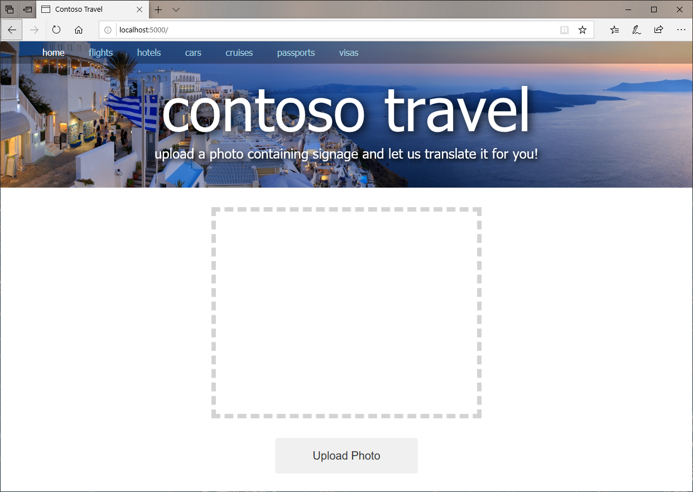
Crie um Site que Suporta Upload de Fotos
Coloque o Flask em modo DEV:
Windows: set FLASK_ENV=development
macOS/Linux: export FLASK_ENV=development
Inicie o Flask:
flask run
Open website locally:
http://localhost:5000
Notes:
Return to the command prompt window or terminal where your virtual Python environment is active, and make sure that the project directory is the current directory.
Note: If you closed the command prompt window or terminal after activating the virtual environment, simply open a new one, use cd to switch to the project directory, and use the env\scripts\activate command (Windows) or source env/bin/activate command (macOS and Linux) to activate it again.
If you are running Windows, run the following command to create an environment variable named FLASK_ENV that tells Flask to run in development mode:
set FLASK_ENV=development
If you are running Linux or macOS, use this command instead:
export FLASK_ENV=development
Running Flask in development mode is helpful when you’re developing a website because Flask automatically reloads any files that change while the site is running. If you let Flask default to production mode and change the contents of an HTML file or other asset, you have to restart Flask to see the change in your browser.
Now use the following command to start Flask:
flask run
Open a browser and navigate to http://localhost:5000. Confirm that the website appears in the browser as shown in the slide.
The page isn’t functional yet. It doesn’t support photo uploads, even though the user interface for doing so is in place. The next step is to modify the site to allow users to upload photos.

Slide 53
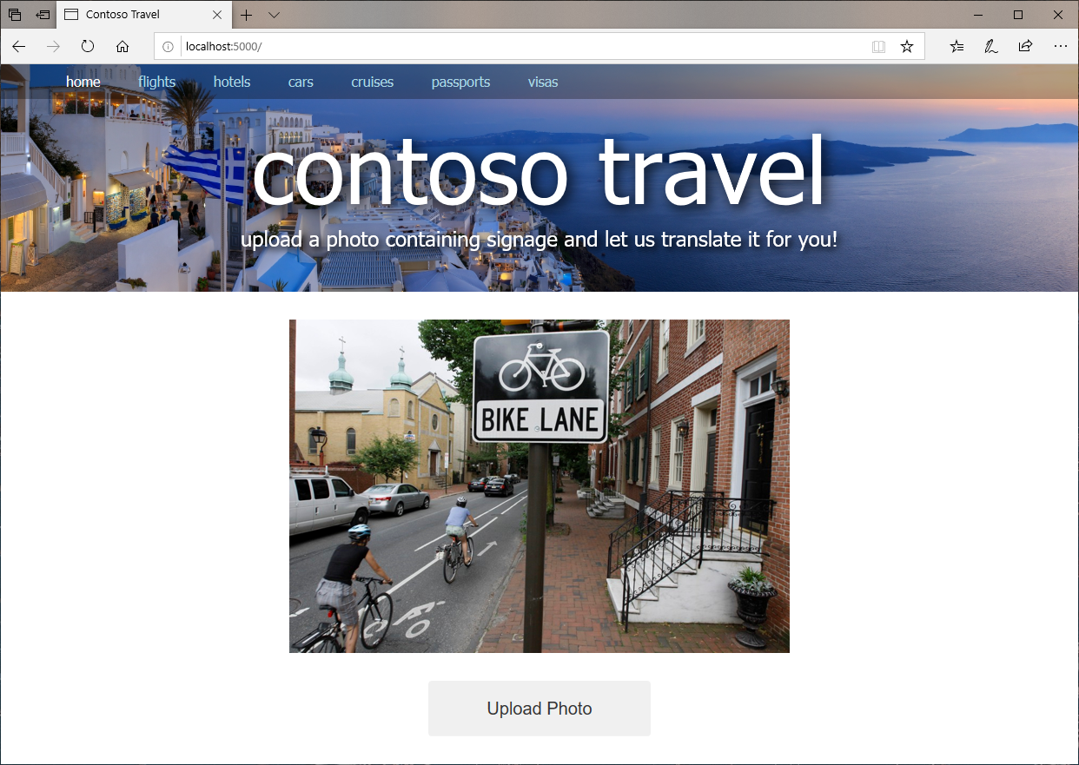
Crie um Site que Suporta Upload de Fotos
Faça upload de uma foto do seu sistema
Notes:
Make sure that your changes have the desired effect by uploading a photo to the site.
Assuming that Flask is still running in the project directory (if it’s not, you can start it again with a flask run command), either refresh the page in your browser or open a new browser instance and navigate to http://localhost:5000.
Click the Upload Photo button and select a photo from your local file system.
Confirm that the photo you selected appears on the slide.
You now have a basic Flask website running that accepts photo uploads. The next step is to modify the site to extract text from those photos. That’s where Azure Cognitive Services come in.

Slide 54
Faça uso dos Serviços via CLI
From the command prompt:
Create resource
group
az group create --name contoso-travel-rg --location northcentralus
az cognitiveservices account create --resource-group contoso-travel-rg --name computer-vision --location northcentralus --kind ComputerVision --sku F0 --yes
Place resource
in group
az cognitiveservices account keys list --resource-group contoso-travel-rg --name computer-vision --query key1 --output tsv
Obtain
API key
az cognitiveservices account keys list --resource-group contoso-travel-rg --name computer-vision --query endpoint --output tsv
Obtain
Endpoint URL
Be sure to save your API key and endpoint URL to use later.
Notes:
THIS IS THE KEY SLIDE – get here as fast as possible
Azure Cognitive Services is a set of more than 20 services and APIs for infusing intelligence backed by machine learning and neural networks into the applications that you write. One member of the Cognitive Services family is the Computer Vision API, which can analyze images uploaded to it and:
Identify objects in the images.
Generate captions for the images (for example, “A woman riding a bicycle”).
Use Optical Character Recognition (OCR) to extract text from the images.
Find faces in the images and identify attributes of those faces such as age and gender.
Generate “smart thumbnails” centered around the subjects of the images.
Recognize famous people and landmarks in the images.
Like all Cognitive Services APIs, the Computer Vision API is invoked by placing calls over the Internet to a REST endpoint. Rather than placing those calls directly, you can use the Python SDK for the Computer Vision API to simplify your code. The SDK abstracts calls to the Computer Vision API and handles JSON payloads for you so that you don’t have to write code to generate and consume JSON yourself.
It is the OCR feature of the Computer Vision API that will enable the Contoso Travel site to extract text from images. In this unit, you will modify Contoso Travel to use the Computer Vision API to extract text from photos uploaded to the site.
Subscribe to the Computer Vision API
To call the Computer Vision API, you must first obtain an API key. This key travels in each request you place to the Computer Vision API in an HTTP header named Ocp-Apim-Subscription-Key. It is Azure’s way of authenticating the caller and determining which Azure subscription to bill calls to. Most Azure Cognitive Service APIs have free tiers for which no billing is performed, but if you plan to place thousands of calls a day to a Cognitive Services API, you will be billed for it through your Azure subscription.
You can obtain a Computer Vision API key using the Azure CLI or the Azure Portal. In this exercise, you will obtain an API key and a corresponding URL for placing calls to the Computer Vision API with that key using the Azure CLI.
If you haven’t already installed the Azure CLI and have signed in for the first time, follow the instructions in an earlier unit for doing so.
Open a command prompt window or terminal, and use the following command to create a resource group named “contoso-travel-rg” in Azure’s North Central US region to hold the Azure resources you create in this module: az group create --name contoso-travel-rg --location northcentralus Resource groups are an incredibly important feature of Azure. They act as containers for other Azure resources and serve to group those resources together so that you can view billing information for them as a group, apply security rules as a group, and even delete them as a group. Every Azure resource that you create must be part of a resource group.
Now use the following command to subscribe to the Computer Vision API and place the resulting resource named “computer-vision” in the resource group created in step 2: az cognitiveservices account create --resource-group contoso-travel-rg --name computer-vision --location northcentralus --kind ComputerVision --sku F0 –yes The --sku F0 parameter subscribes to the free tier of the Computer Vision API that allows up to 20 calls per minute and a maximum of 5,000 calls per month. This is fine for development, but in production, you would want to subscribe to one of the paid tiers that supports more traffic. For a summation of pricing tiers for the Computer Vision API, see Cognitive Services Pricing — Computer Vision API.
Use the following command to obtain an API key for the Computer Vision API: az cognitiveservices account keys list --resource-group contoso-travel-rg --name computer-vision --query key1 --output tsv The output from the command is a string containing numbers and letters. This is your Computer Vision API key. Copy the key into a text file and save it so that you can easily retrieve it later. You will need it later in this unit and in a subsequent unit.
Use the following command to obtain an endpoint URL for calling the Computer Vision API: az cognitiveservices account keys list --resource-group contoso-travel-rg --name computer-vision --query endpoint --output tsv Once more, save the URL output from the command in a text file so that you can easily retrieve it later. This URL is the one that you will use to call the Computer Vision API.
The choice of North Central US as the region for your Computer Vision API resource and the resource group that holds it isn’t arbitrary. You can locate a resource group and its resources in any of the more than 50 regions that Azure supports. However, it is desirable to locate the resources that comprise a resource group in the same region to minimize cost and maximize performance. The Computer Vision API isn’t supported in all regions, but it is supported in North Central US. For a list of regions in which various Cognitive Services are available, refer to Products available by region.

Slide 55
Configure o Ambiente
Modifique os aplicativos como indicado no GitHub
Você precisa mudar o app.py e o index.html como indicado no manual.
Crie as variáveis de ambiente para executar o serviço
Windows
set VISION_KEY=computer_vision_api_key set VISION_ENDPOINT=computer_vision_endpoint
macOS/Linux
export VISION_KEY=computer_vision_api_key export VISION_ENDPOINT=computer_vision_endpoint
Notes:
Modify the Site to Use the Computer Vision API
You have now subscribed to the Computer Vision API and obtained an endpoint and an API key for calling it. The next step is to modify the Contoso Travel site to use these values to call the Computer Vision API and extract text from photos.
Open app.py and replace its contents with those in the manual.
The modified app.py defines a function named extract_text_from_image() that accepts an image and a ComputerVisionClient instance. It calls ComputerVisionClient.recognize_printed_text_in_stream() to pass the image to the Computer Vision API and returns one or more lines of text representing the text extracted from the image, a message indicating that no text was found, or an error message indicating that something went wrong.
The index() function calls extract_text_from_image() each time a photo is uploaded and uses Flask’s flash() function to “flash” the results.
ComputerVisionClient comes from the Python SDK for the Computer Vision API. An instance is created and initialized with your Computer Vision API endpoint and API key when the application starts up. The endpoint and API key are read from environment variables using Python’s os.environ mapping object.
Now open index.html and insert the code from the manual and markup before the <script> element at the bottom of the page.
The first section defines a modal dialog box using Bootstrap. The second section populates the dialog box with the lines of text returned by extract_text_from_image() and flashed by index(), and it displays the dialog box in the page.
Finish up by saving your changes to index.html and app.py.
Extract text from photos
Now let’s run the modified site, upload a few photos, and see if the Computer Vision API lives up to its billing.
If you are running Windows, run the following commands to create environment variables containing the API key and endpoint you retrieved for the Computer Vision API, replacing computer_vision_api_key with the API key and computer_vision_endpoint with the endpoint URL:
set VISION_KEY=computer_vision_api_key set VISION_ENDPOINT=computer_vision_endpoint
If you are running Linux or macOS, use these commands instead:
export VISION_KEY=computer_vision_api_key export VISION_ENDPOINT=computer_vision_endpoint
When the site is running locally, calls to os.environ load these variables from the environment. Later, when you deploy the site to Azure, the same variables will come from application settings in Azure, with no code changes required.

Slide 56
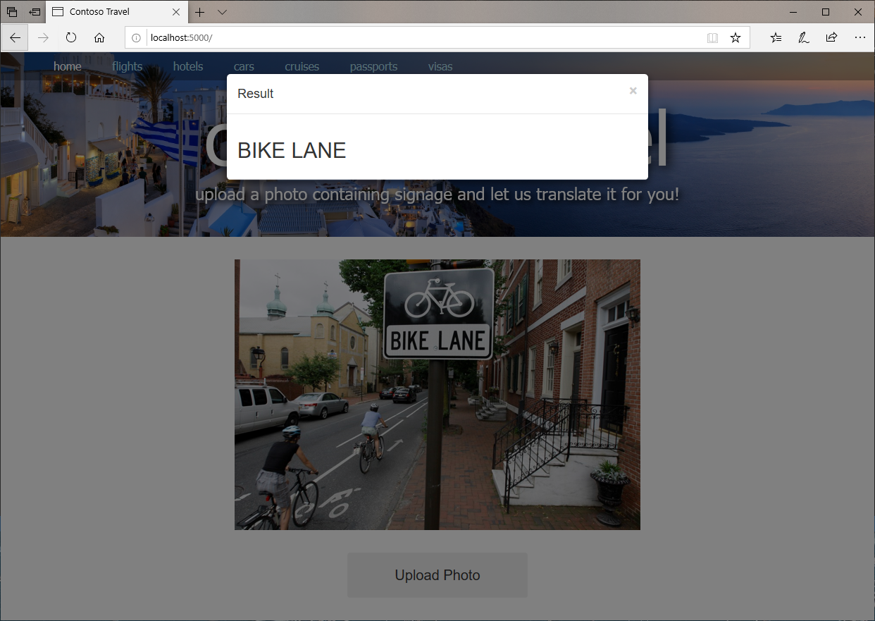
Teste seu Sítio (APP)
Abra localmente:
http://localhost:5000
Verifique que está extraindo texto
Notes:
Navigate to http://localhost:5000 in your browser. Click the Upload Photo button and upload a picture that contains text. Confirm that after a brief pause, the text extracted from the photo appears in a modal dialog box. Then dismiss the dialog box.
Repeat this process with other photos to gauge the Computer Vision API’s ability to extract text from the photos you upload. It isn’t perfect, but it should get it right—or almost right—most of the time.

Slide 57
Criando Chaves via CLI
Faça uma inscrição no serviço de tradução
az cognitiveservices account create --resource-group contoso-travel-rg --name translator-text --location global --kind TextTranslation --sku F0 --yes
Obtenha a chave da mesma
az cognitiveservices account keys list --resource-group contoso-travel-rg --name translator-text --query key1 --output tsv
Be sure to save your API key to use later.
Notes:
The Translator Text API is the component of Azure Cognitive Services that translates text from one language to another. It relies on state-of-the-art Neural Machine Translation (NMT) to work its magic and supports more than 60 languages.
Like the Computer Vision API, the Translator Text API is invoked using REST calls over the Internet. Unlike the Computer Vision API, the Translator Text API currently has no Python SDK available. That doesn’t mean that you can’t use it from a Python application. It means that you must invoke the API by using raw HTTP requests and write code to parse the JSON payloads that are returned.
It’s not as hard as it sounds, as you will prove when you modify the Contoso Travel site to pass text extracted from photos by the Computer Vision API to the Translator Text API for translation into another language.
Subscribe to the Translator Text API
To call the Translator Text API, you must obtain an API key. As with the Computer Vision API, this key travels in each request you place to the Translator Text API in an Ocp-Apim-Subscription-Key header and maps calls to Azure subscriptions.
In a command prompt window or terminal, use the following command to subscribe to the Translator Text API and place the resulting resource named “translator-text” in the resource group you created earlier:
az cognitiveservices account create --resource-group contoso-travel-rg --name translator-text --location global --kind TextTranslation --sku F0 –yes
Unlike the Computer Vision API, which requires you to specify an Azure region, the Translator Text API is a “global” API that doesn’t live in a specific region. That’s the reason for the --location global parameter. Among other things, this means that you don’t have to retrieve an endpoint URL for the Translator Text API as you do for the Computer Vision API. One endpoint— https://api.cognitive.microsofttranslator.com/translate?api-version=3.0—serves all regions.
Use the following command to obtain an API key for the Translator Text API:
az cognitiveservices account keys list --resource-group contoso-travel-rg --name translator-text --query key1 --output tsv
The output from the command is a string containing numbers and letters. This is your Translator Text API key. Copy the key into a text file and save it so that you can easily retrieve it later. You will need it later in this unit and in a subsequent unit.
This API key uses the Text Translator API’s free tier (--sku F0), which supports translating up to 2,000,000 characters of text per month. In a production environment, you would want to subscribe to one of the paid tiers documented here.

Slide 58
Configure o Ambiente
Modifique os aplicativos como indicado no GitHub
Você precisa mudar o app.py e o index.html como indicado no manual.
Crie as variáveis de ambiente para executar o serviço
Windows
set TRANSLATE_KEY=translator_text_api_key
macOS/Linux
export TRANSLATE_KEY=translator_text_api_key
Notes:
You have now subscribed to the Translator Text API and obtained an API key for calling it. The next step is to modify the Contoso Travel site to use the Translator Text API to translate text extracted from photos with the Computer Vision API.
Open index.html and insert the statements from the manual at line 42, just before the <img> element. (The modified markup showing the correct positioning of the new block is shown in the manual).
The added markup defines a drop-down list (an HTML <select> element) with a selection of languages that can text can be translated into.
Also in index.html, add the following statement to the <script> block at the bottom of the page:
$("#language").val("{{ language }}");
(An example of how the modified <script> block should look is in the manual).
The purpose of the added statement is to initialize the drop-down list with the currently selected language. Without this statement, the drop-down list would revert to the default language (“English”) each time a photo is uploaded.
Open app.py and replace the first line with this one:
import os, base64, json, requests
Next, add the following statements right after the statements that create a ComputerVisionClient instance near the top of the file to fetch the Translator Text API key:
# Retrieve the Translator Text API key translate_key = os.environ["TRANSLATE_KEY"]
Replace the index() function with the one shown in the manual. The new index() function reads the language selected in the drop-down list from the request and passes it to translate_text(), which translates the text into the specified language. Then it flashes the translated text so that index.html will present it to the user.
Finally, add the translate_text() function to the end of app.py as detailed in the manual. This function calls the Translator Text API to translate the text passed to it. It returns the translated text if the translation succeeded, or an error message if something went wrong.
Note: An interesting aspect of this code is that if the call to the Computer Vision API returns an error message or a message indicating that no text was detected in the photo, the message itself is translated into the language that the user selected.
The final step is to test the changes that you made by uploading photos to the site and allowing the Translator Text API to translate the text in them.
If you are running Windows, use the following command to create an environment variable containing the API key you retrieved for the Translator Text API, replacing translator_text_api_key with your key:
set TRANSLATE_KEY=translator_text_api_key
If you are running Linux or macOS, use this command instead:
export TRANSLATE_KEY=translator_text_api_key

Slide 59
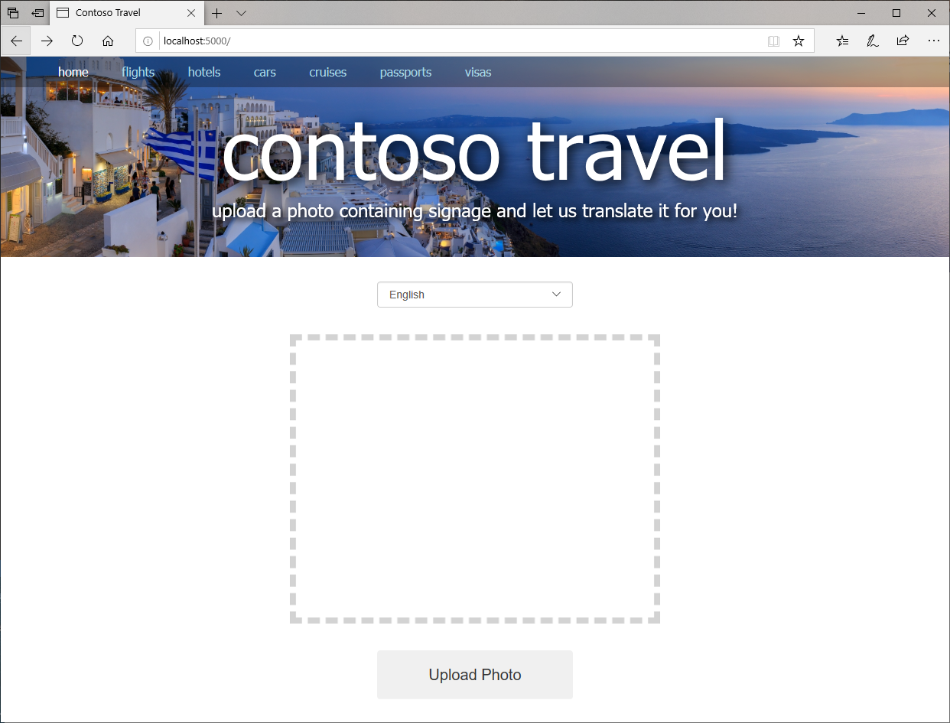
Faço uso do seu novo Sítio!
Abre a URL
http://localhost:5000
Faça upload de uma foto!
Notes:
Navigate to http://localhost:5000 in your browser. Confirm that the page now contains a drop-down list for selecting a language, as pictured in the slide.

Slide 60
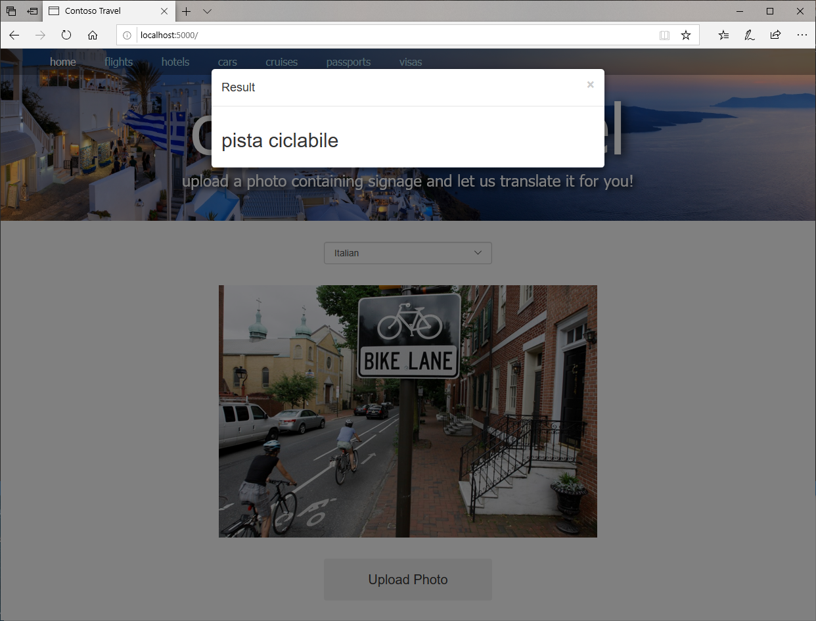
Faço uso do seu novo Sítio!
Abre a URL
http://localhost:5000
Faça upload de uma foto!
Verifique a Resposta!
Notes:
Select the language that you want to translate text into from the drop-down list. Then click Upload Photo and upload a picture containing text.
Confirm that after a brief pause, the text extracted from the photo and translated into the language you specified appears in a modal dialog. Then dismiss the dialog.
Repeat this process with other photos to gauge the Translator Text API’s ability to translate text submitted to it.

Slide 61
Faça a Implantação (Deploy)
Crie um serviço de APP da Azure
No diretório do projeto, garante que existe um requirements.txt com o conteúdo abaixo
requests Flask azure-cognitiveservices-vision-computervision
Na linha de comando execute. Mude a região se necessário
az webapp up -n APP_NAME --resource-group contoso-travel-rg --location northcentralus
Note: APP_NAME must be unique with Azure.
Adicione as chaves no seu APP
Execute os seguintes comandos
az webapp config appsettings set -g contoso-travel-rg -n APP_NAME --settings VISION_KEY=computer_vision_api_key
az webapp config appsettings set -g contoso-travel-rg -n APP_NAME --settings VISION_ENDPOINT=computer_vision_endpoint
az webapp config appsettings set -g contoso-travel-rg -n APP_NAME --settings TRANSLATE_API_KEY=translate_api_key
Notes:
Azure App Service is a set of services provided by Microsoft Azure to enable developers to easily build and deploy web apps. Included in the App Service family are Azure Web Apps, which allow you to quickly and easily deploy websites built with tools and languages you’re already familiar with.
Azure Web Apps make deploying websites extraordinarily easy—and not just websites built using the Microsoft stack. You can deploy Python apps that use MySQL just as easily as ASP.NET apps that use SQL Server. You can select from a wide variety of Azure Web App templates or build templates of your own. You can configure Azure Web Apps to auto scale as data traffic increases to ensure that your customers aren’t left waiting during periods of peak demand. You can publish apps to staging locations and test them in the cloud before taking them live, and then swap staging and production with the click of a button. You can even create WebJobs—programs or scripts that run continuously or on a schedule to handle billing and other time-critical tasks. In short, Azure Web Apps take the pain out of publishing and maintaining web apps and are just as suitable for a personal photo-sharing site as they are for enterprise-grade sites serving millions of customers.
In this unit, you will deploy Contoso Travel to Azure as an Azure Web App so it can be accessed by anyone, from anywhere, using a browser. And you will learn about App Service application settings, which allow API keys and other “secrets” used by an application to be stored securely in the cloud.
Create an Azure App Service
In this exercise, you will use the Azure CLI to deploy your website to Azure.
Create a text file named requirements.txt containing the following statements in the project directory—the directory containing the Contoso Travel site:
Requests
Flask
azure-cognitiveservices-vision-computervision
requirements.txt contains a list of Python packages that must be installed along with the app when the app is deployed to Azure.
Open a command prompt window or terminal and run cd to switch to the project directory.
Run the command below to deploy the website to Azure, replacing APP_NAME with the name you want to assign to the site. The name must be unique within Azure, so you probably won’t be able to use a common name such as “contoso” or “contosotravel” unless you append some random characters to the end. az webapp up -n APP_NAME --resource-group contoso-travel-rg --location northcentralus The az webapp up command creates an Azure App Service to host your website, configures the App Service with the packages specified in requirements.txt, zips the files in the current directory and its subdirectories, and uploads the site to the App Service—all with one simple command. Sites that run on Node.js and Python are deployed to Linux App Services, whereas sites built on ASP.NET and ASP.NET Core run in Windows App Services.
Note: Observe that you deployed the App Service in the same region (North Central US) as the Computer Vision API. This makes calls to the API faster by colocating the website and the API that it uses in the same Azure region.
Wait for the command to complete; it will take a few minutes. Then confirm from the output that the website was successfully deployed.
Add Application Settings
When you ran the website locally, it used os.environ to load API keys for the Computer Vision API and the Translator Text API and the URL of the Computer Vision API from local environment variables. For the site to run in Azure, these same settings need to be added to the Azure App Service’s application settings. In the steps that follow, you will use the Azure CLI to create these application settings in Azure and initialize them with the same values that were used when you loaded them into local environment variables.
Run the following CLI command to create an application setting named “VISION_API_KEY,” replacing APP_NAME with the name assigned to your App Service and computer_vision_api_key with your Computer Vision API key: az webapp config appsettings set -g contoso-travel-rg -n APP_NAME --settings VISION_KEY=computer_vision_api_key
Now use this command to create an application setting named “VISION_ENDPOINT,” replacing computer_vision_endpoint with your Computer Vision API endpoint: az webapp config appsettings set -g contoso-travel-rg -n APP_NAME --settings VISION_ENDPOINT=computer_vision_endpoint
Finish by using the following command to load your Translator Text API key into application settings, replacing translate_api_key with your API key: az webapp config appsettings set -g contoso-travel-rg -n APP_NAME --settings TRANSLATE_API_KEY=translate_api_key

Slide 62
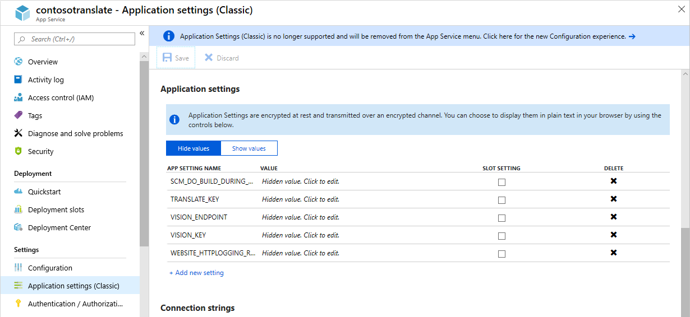
Faça a Implantação (Deploy)
Opcional: va para
http://portal.azure.com
Olhe para o seu novo aplicativo
Notes:
If you want, you can sign in to the Azure Portal, open the Azure App Service created by the az webapp up command, and view the application settings that these commands created. The screen shot below illustrates what you will see if you do this.

Slide 63

Verifique se o APP Funciona
Abra o sítio Azure:
https://APP_NAME.azurewebsites.net
Verifique tudo funciona corretamente
Sucesso!
Notes:
Now it’s time to see the website up and running in Azure.
Point your browser to http://APP_NAME.azurewebsites.net, replacing APP_NAME with the name of your App Service. Confirm that the site appears in your browser and that it looks exactly as it did when running locally.
Choose a language and upload a few photos containing signs with text that you want to translate. Does the site behave the same in Azure as it does when run locally?
If you later make changes to your site and want to update the App Service in Azure, simply run the az webapp up command again. Rather than create a new App Service, it will zip deploy the files in the current directory to the existing App Service. If you would prefer to put the source code files under source control and deploy them directly from Visual Studio Code, just follow the instructions in Deploy to Azure App Service on Linux.

Slide 64
Reconhecimento Facial
Notes:
Learn Face API
Compare/contrast prebuilt cog services vs ones that you train
Face API & ethics –
Government, face recognition
Training ethically – bad at dark skinned women. Hasn’t seen enough examples. Can only recognize what it’s seen
Facial recognition provides a good context for discussing the ethics of AI because everyone has a face. Earth is filled with more than 7,500,000,000 faces, and although faces change over time with age and other conditions, the human brain excels in its ability to detect, identify, and recognize faces. AI has made remarkable strides in facial recognition as well, sometime exceeding human capabilities. Automating facial recognition opens new opportunities and also poses new risks, which makes the discussion of ethics an important part of learning about AI.

Slide 65
Sumário do Reconhecimento Facial
Learn about the Face API and AI-driven facial recognition in general.
Discuss ethical considerations about AI in the context of facial recognition.
Use the Face API hands-on.
Assumptions
None. Although this section assumes that you have completed the Microsoft Vision and Language Cognitive Services Hands-on section, that is not a prerequisite for getting the most out of this section.

Slide 66

Notes:
Example
Five layers:
Input Layer (pictures including faces–3 Polaroids)
Edges
Nose/Ears/Eyes/Mouths
Whole Faces
“This is probably Bill”
Our sci-fi future, powered by DNN:
Composing Models
Extracting Style
Your Choice
Main Point: DNNs don’t just answer questions, they allow us to create and transform

Slide 67

API de Faces: Funcionamento
Notes:
Now that you’ve seen a little of what the Face API can do, let’s examine how the Face API works on our road to discussing the ethics of AI.
As a user, you interact with Microsoft’s facial recognition algorithms through an API. The Face API exposes these algorithms as REST-based web service calls, to detect, verify, identify, and analyze faces. The service can provide face matching, face attributes, and characteristic analysis. It can also extract face-related attributes, such as emotion. The Face API can also organize people and facial definitions into groups to locate similar faces.
The tasks performed by the Face API fall into five categories:
Detection: Detect human faces in an image.
Similarity: Find similar faces.
Grouping: Organize unidentified faces into groups, based on their visual similarity.
Verification: Check the likelihood that two faces belong to the same person.
Identification: Search and identify faces.
The tasks that the Face API performs drive the face-related data that the API returns.

Slide 68


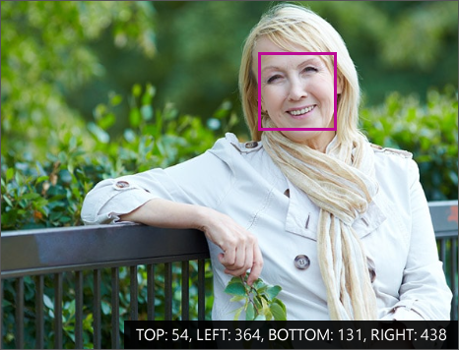
Tipos de Dados Faciais
Atributos
Local
Pontos Chave
Notes:
The Face API returns three kinds of facial data: the locations of faces in images, the landmarks of faces in images, and the attributes of faces in images.
Locations
A face location is another term for a collection of face coordinates. The location is a rectangular pixel area in the image where a face has been identified. This location consists of the pixel coordinates of the top, left, bottom, and right edges of the region in the image that contains a face.
Landmarks
Face landmarks are detailed points on a face. Collections of these points (such as the chart on this slide) provide rough sketches of individual human faces. These landmarks identify common facial elements, such as a pupil, nose, or eyebrow, by using pixel coordinates. The Face API can return up to 27 landmarks for each identified face that you can use for analysis.
Attributes
Face attributes are predefined properties of a face or properties that identify a person by a face. The Face API can optionally identify and return the following types of attributes for a detected face:
Age
Gender
Smile intensity
Facial hair
Head pose (3D)
Emotion
This facial data enables facial recognition through AI.

Slide 69
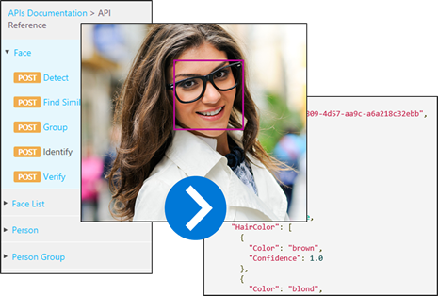
Resumo de Reconhecimento Facial
Notes:
The face-detection feature of the Face API provides information about detected faces in an image, but it isn't designed to identify or recognize a specific face. However, the Face API provides this capability through a facial recognition feature.
Facial recognition is used in many areas, including security, natural user interfaces, image analysis, mobile apps, and robotics. The ability to use artificial intelligence to recognize and match faces is one of the more powerful aspects of the Face API. It is also an aspect of AI that encapsulates a many ethical questions about AI, which we will discuss later in this section.
Face Detection vs. Facial Recognition
Facial recognition builds on the facial detection API by analyzing the landmarks in two or more pictures to determine whether the same face is present. There are four assessments that can be determined through this analysis:
Does this person look like other people? This defines similarity.
Do all these faces belong together? This defines grouping.
Do two images of a face belong to the same person? This defines verification.
Who is this person in this group of people? This defines identification.
However, performing tasks such as identifying, grouping, and determining the similarity of faces are all predicated on having groups of faces to work with. This is where face lists come in.

Slide 70
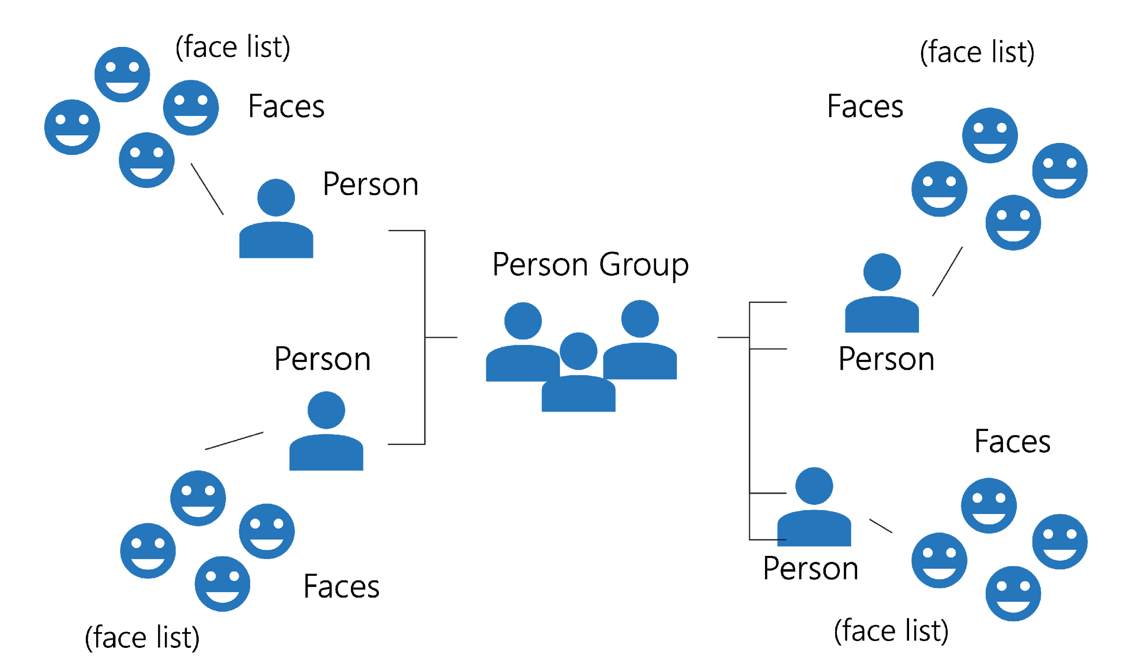
Listas de Faces (Agrupamento)
Notes:
Strictly speaking, a face list is just a group of faces. Creating and managing face lists enables users to find similar faces in a fixed collection of faces. For example, you could use a face list to find a similar face in a set of pictures of celebrities, friends, or family members.
A face list relates to several concepts:
Face: An image of a single face.
Face list: A collection of distinct face images.
Person: A record of a single individual; there can be multiple pictures of the same person in a face list.
Person group: A collection of persons, each of whom can be associated with multiple faces in the face list.
Relationships among these terms can get a little fuzzy, so it's helpful to visualize them in a diagram (see slide).
Face lists are useful when you're working on face identification and face similarity.

Slide 71
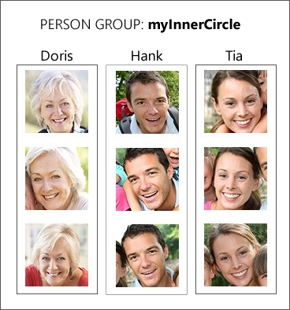

Mais Listas de Faces
Face similarity
Face identification
Notes:
Face Identification
You can use the Face API to identify people by comparing a detected face to a person group. Remember, a person group is like a database of people. For example, you might create a person group named myInnerCircle as in the slide above.
You can use a different face to perform identification against the person group. If the face is identified as a person in the group, the person object is returned as a match.
Face Similarity
Face lists are a great way to determine face similarity. For example, if you compare a target face against a face list, the Face API might return a small collection of faces that look like the target face. The Face API supports two working modes: match face and match person.
Match person returns similar faces after applying a same-person threshold that's derived from face verification.
Match face returns similar faces by ignoring the same-person threshold.
In the following image, face similarity would find that the first and second faces are the same person. It would also find that the third and fourth faces are similar.
These details and the others that we have examined so far in this section are the technical details of working with face data and the Face API. But what are the ramifications of using these AI capabilities in the real world?

Slide 72
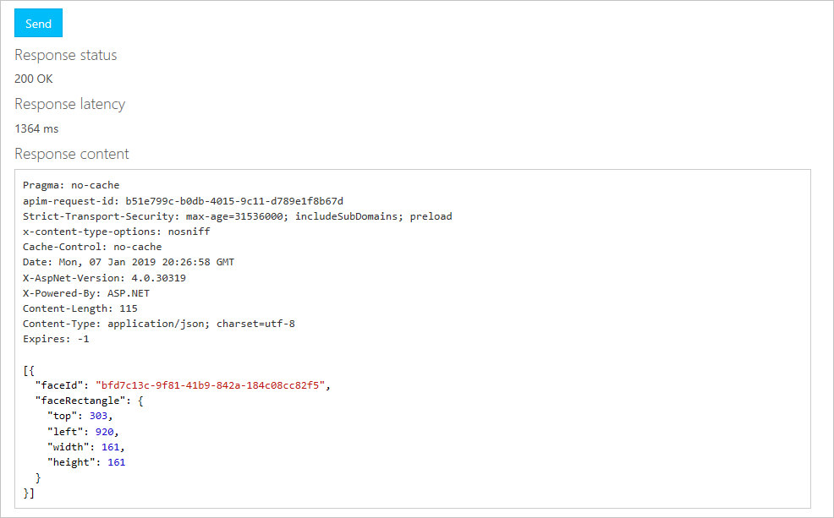
Test the Face Detection API
Your HTTP response should look something like this.
Notes:
//Bad demo
//Do the good one on the GitHub repo.

Slide 73
Responsabilidade e Ética

Slide 74

Ética no tempo de IA
Notes:
Of course, making AI more accessible puts the power of AI in more hands, for better or worse. With broader use of AI, understanding the ethical dimension of AI becomes even more important. As we learned today, AI capabilities such as facial recognition can automatically raise privacy concerns because everyone has a face and an identity tied to that face. Not only is avoiding problems such as bias imperative when building models, but the use of AI should be done with consideration for users’ privacy and for protecting their data. Tapping into the power of AI for your applications involves you in these concerns about how to harness AI in a responsible way.

Slide 75

Privacidade
ML e IA são 100% dependente de dados
Alguns serviços guardam dados
Hoje em dia, existem regulamentos sobre quais dados pode ser guardados
Este slide não é cobre, nem de perto, todos os aspectos!
GDPR
LGPD
Notes:
It is the fuel for effective AI. It is not just the recent advances in computing power that make AI technologies like deep learning work, but the massive amounts of data now available for training AI. In general, the more data that can be acquired for uses like retraining and retuning AI models, the more effectively those models can work.
This need for data certainly holds true for Azure Cognitive Services. For example, by default, services like LUIS store every utterance to improve the service. While great for improving AI accuracy, you should always bear in mind that all data—particularly data gathered from users—brings with it potential privacy and regulatory considerations. For example, in the case of LUIS, storing that language data coming from users might create a compliance issue with data privacy rules such as the European Union General Data Protection Regulation (GDPR).
A course like this cannot (and should not) give legal advice. However, it is good to think through the privacy ramifications of the AI services you choose to include with your apps and to seek legal advice in order to remain compliant with the relevant regulations as you provide valuable new features to your users.

Slide 76

IA pode ser sua Ferramenta mais Poderosa
Aprendizado Profundo atualmente é uma das mais importantes tecnologias em diversos contextos
Com o Serviço Cognitivo da Azure, você pode fazer uso de tal tecnologia de forma simples!
Fácil de integrar nas suas aplicações
Como vimos
Notes:
AI based on deep neural networks provides very good results for a variety of use cases ranging from text translation to computer vision—and everything in between. The accuracy and capabilities of AI for these types of workloads can often exceed what many organizations could build themselves with traditional machine learning (ML) by using algorithms that are not based on deep learning.
Because Microsoft has already invested in the hardware and done the hard, time-intensive work of training these deep-learning models, Microsoft Cognitive Services does away with the traditional obstacles of using these powerful AI tools. Access to these AI tools is only an API call away, and you can easily enhance your applications with AI capabilities. You pay only for what you need, when you need it.

Slide 77
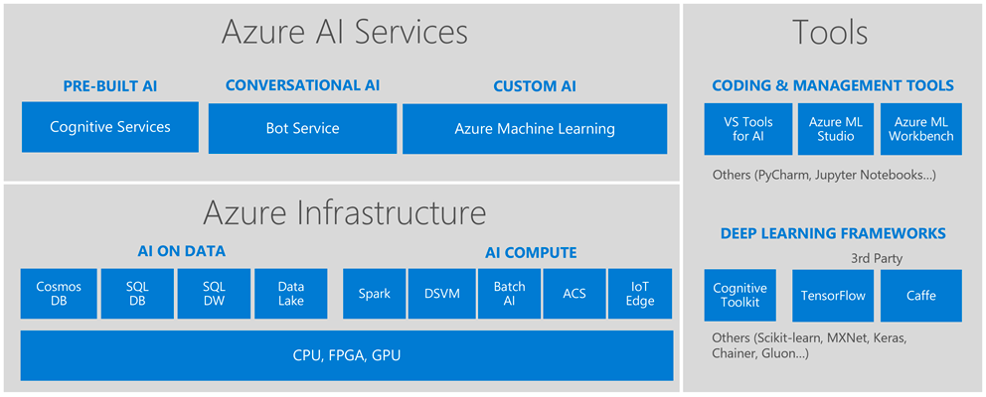
Plataforma de IA da Microsoft
Azure Notebooks
PyTorch
Sci-kit Learn
https://docs.microsoft.com/learn/modules/choose-data-science-option-in-azure/2-ml-options-on-azure
Notes:
So we’ve learned about pre-built AI but what happens when you’ve gotten to the point where you want to build your own models? Turns out that Microsoft has already many of those “building blocks” too because that’s how we build intelligence into our own products like Cortana, Office, Windows, and XBOX.
//you’re recapping this first part to reinforce the highest priority concepts. This is the most important part for student developers.
And you don’t have to be an expert coder to start building with it:
AI Services: Use these high-level “finished” services to add intelligence to your apps. In addition to computer vision, speech, and language, we also have our own Bot service.
AI Tools: If you want to start exploring training your own machine learning models but don’t have a lot of coding experience, try the Azure Machine Learning Studio, the drag and drop tool for training and deploying predictive models. It also supports custom Python and R coding modules.
But maybe you have already started learning python Pandas and tools like Sci kit learn to train your own models.
AI Infrastructure:
Tools like Azure Data Lake allow you to access data from multiple data sources to train your models. You might already be familiar with the basics for databases through SQL Server or Blob storage.
The Data Science Virtual Machine saves you time with pre-installed tools (more on that later).
AI Tools:
Azure ML Workbench allows you to write your own Python code to train models.
Azure Notebooks is the Azure implementation of Jupyter Notebooks.
Or maybe you’re ready to build your own models and algorithms on “bare metal” infrastructure.
AI Infrastructure:
Open source tools like Apache spark are supported on Azure.
Batch AI allows you to train models on clusters of virtual machines.
Azure Container Service can help you manage your Kubernetes environment.
AI Tools:
Azure supports open source frameworks like Tensorflow and Caffe where you can use neutral networks to train your models.
Keras in another good solution for rapid prototyping.
Cognitive Toolkit is Microsoft’s own framework for deep learning which is designed for the largest datasets with performance in mind.
//optional: share your personal favorite or recent project on which you’ve worked.

Slide 78
Sumário de Hoje
Você aprendeu como funciona a API de Visão
Você aprendeu como funciona a API de Tradução
Você aprendeu como funciona a API de Faces
Falamos um pouco sobre ética em IA
Falamos sobre a ética em Reconhecimento Facial
Notes:
//1.5 - 2 hours doing it for real
//Christopher did it fast in an hour because he was rushing.
In this section, you got to know a little better how facial recognition works, and likewise the supporting aspects of face-related AI, such as facial detection. You also got to see the Emotion API in action and use the Face API. All of this served as a foundation for discussing and contemplating the ethics surrounding AI—a discussion that we will continue in the concluding section of the workshop.

Slide 79
Obrigado!
Notes:
//1.5 - 2 hours doing it for real
//Christopher did it fast in an hour because he was rushing.
In this section, you got to know a little better how facial recognition works, and likewise the supporting aspects of face-related AI, such as facial detection. You also got to see the Emotion API in action and use the Face API. All of this served as a foundation for discussing and contemplating the ethics surrounding AI—a discussion that we will continue in the concluding section of the workshop.

Slide 80
developer.microsoft.com/reactor/
@MSFTReactor no Twitter
Notes:
Thank you!

